Slide 1

Web-based Watershed Management Tools for 516(e)
U.S. Army Corps of Engineers
Training Workshop
Prepared by:
Department of Agricultural and Biological Engineering | Purdue University
Institute of Water Research | Michigan State University

Slide 2


Context
USACE, the Institute of Water Research (IWR) at Michigan State University, and the Department of Agricultural and Biological Engineering at Purdue University have collaborated on a number of projects over the past decade to provide decision-support tools for sediment loading reductions to the Great Lakes and its tributaries.

Slide 3
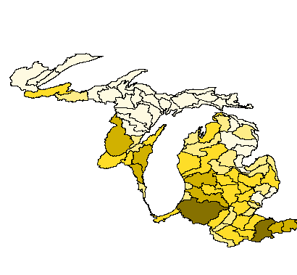

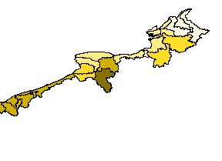
Context
Coarse Basin-wide estimates of sediment loading (2005):
Sediment loading to streams by HUC8
least
less
moderate
more
most
Notes:
HIT’s development began in 2001, when IWR partnered with the U.S. Army Corps of Engineers (USACE) to help reduce USACE’s dredging responsibilities in Great Lakes channels and harbors. IWR combined soil erosion and sediment delivery models to estimate sediment contributions to Great Lakes tributaries, and identify the most likely upland source areas. The principle outcome of this effort was an estimate of annual sediment loading for every 8-digit watershed (hydrologic unit code 8 – HUC8) in the basin (Ouyang et al. 2005). These estimates allowed USACE to begin targeting sediment reduction efforts at a macro-scale. However, to accommodate the broad geographic scope of the analysis, IWR had to generate these sediment estimates at very coarse resolutions of 90m². With continued USACE support, and through an NRCS Conservation Innovation Grant (CIG), IWR refined this initial effort and produced basin-wide estimates at minimum 30m² resolutions and developed a website to provide decision-support capabilities to users at federal, state, and local scales (O’Neil 2009).

Slide 4
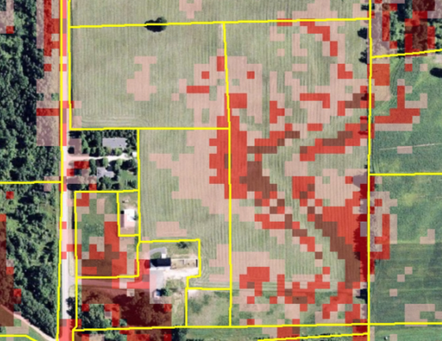
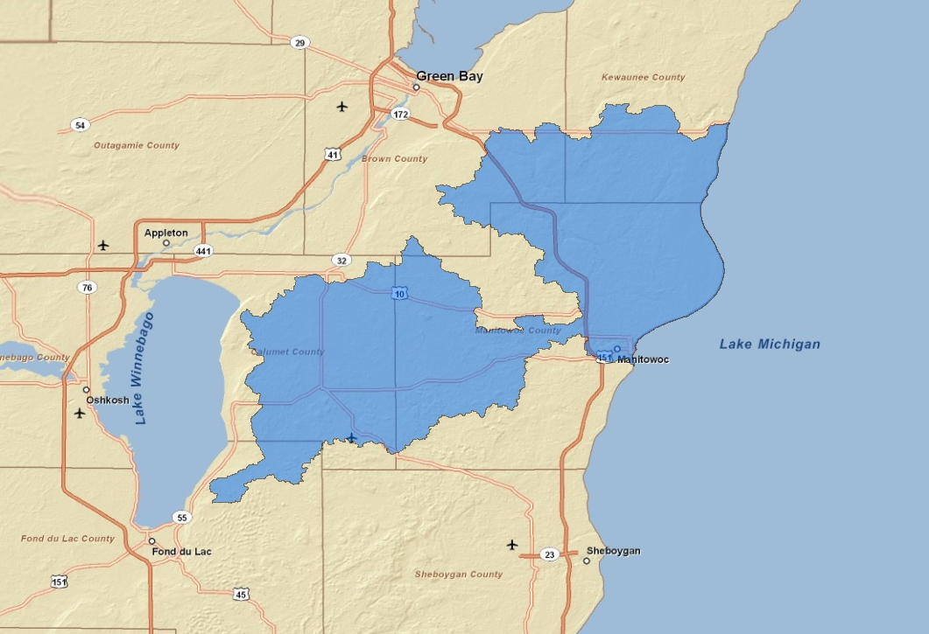
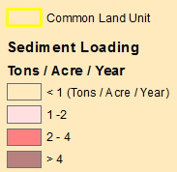
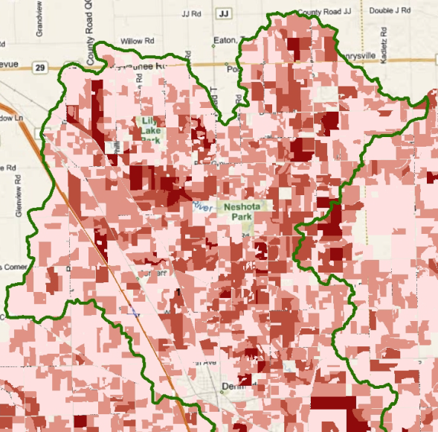
Context
Finer watershed specific sediment models (2011):
Manitowoc and Twin Rivers of eastern Wisconsin
Field-level
prioritization
Notes:
IWR continues to refine HIT by developing finer-resolution models on a watershed-by-watershed project basis, incorporating new and richer model inputs, improving model processing time, and enabling dynamic web-based scenario modeling.

Slide 5
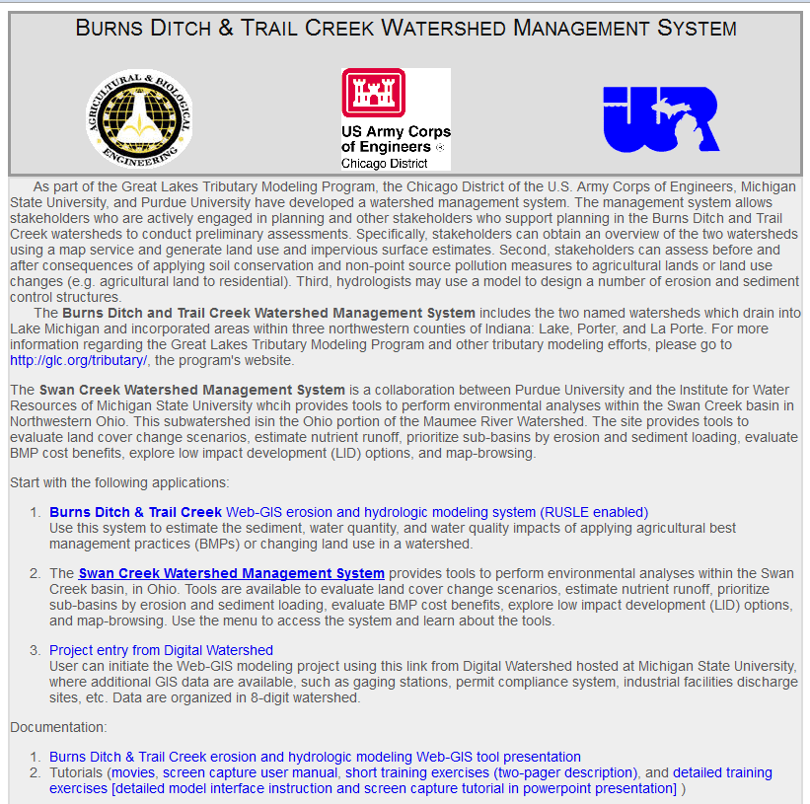
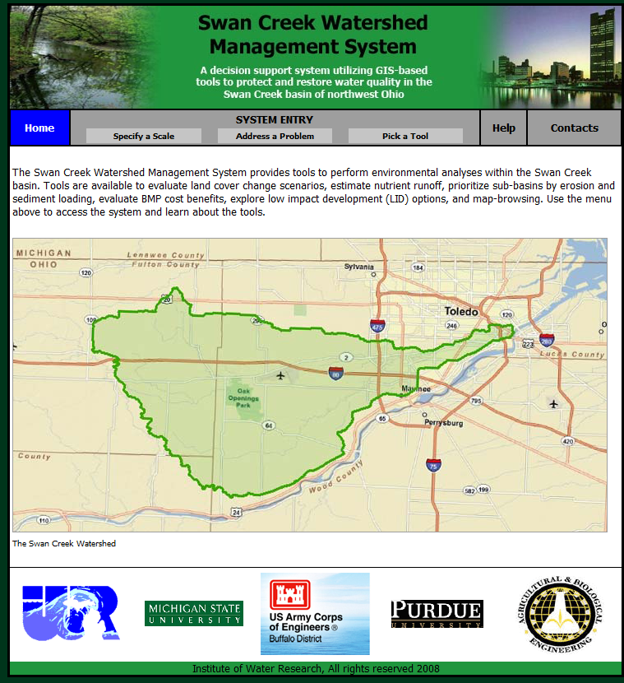
Context
Integrated web-based decision support tools
(L-THIA, Digital Watershed, HIT):
Burns Ditch of northern Indiana (2007)
Swan Creek of NW Ohio (2009)

Slide 6
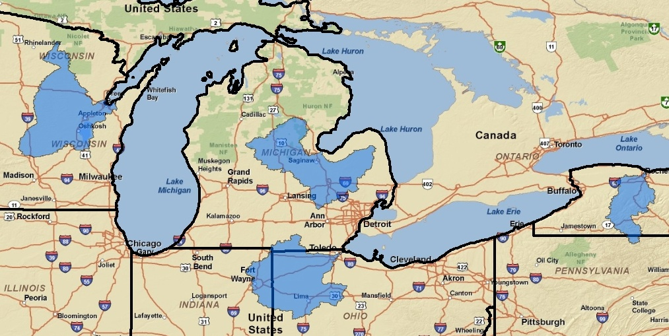
Context
Integrated web-based decision support tools
(L-THIA, Digital Watershed, HIT):
GLRI Priority Basins (end of 2012)
Notes:
Ongoing work to create finer models for GLRI target watersheds

Slide 7
Context
Formal training materials for these tools are needed to engage a broader user group and ensure proper interpretation.

Slide 8
Digital Watershed
High Impact targeting long-term hydrologic impact assessment lid
Overview
Notes:
map portal to watershed scale environmental data across the entire U.S.

Slide 9
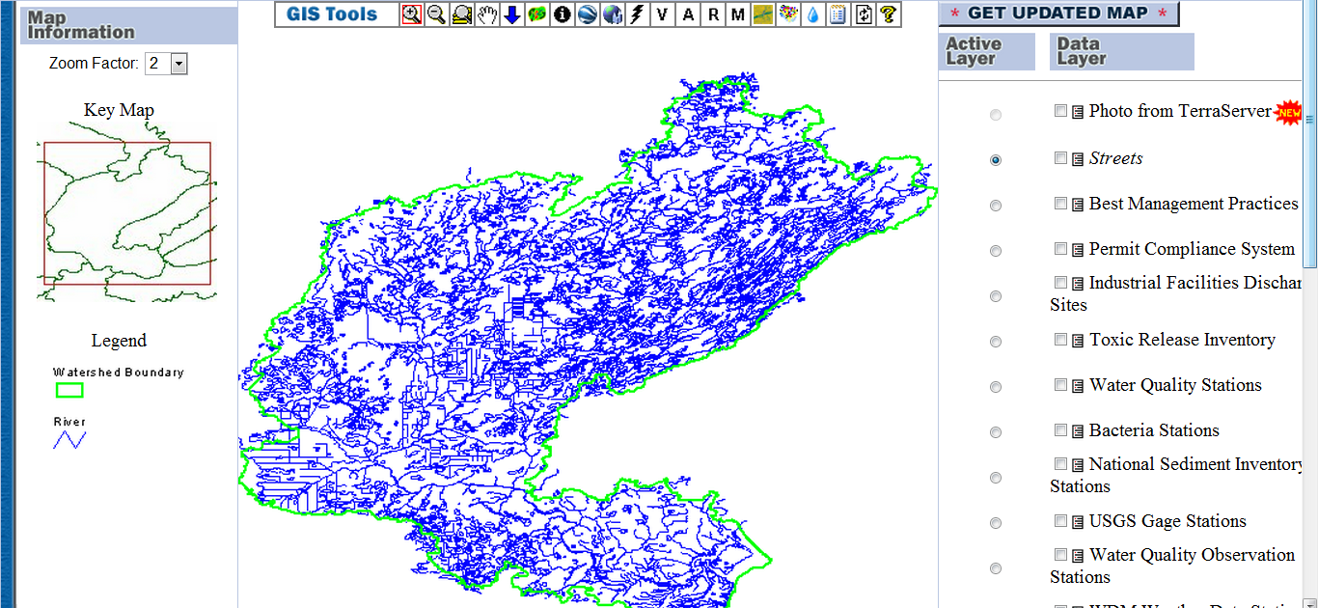
Digital Watershed
Centralized information repository & computing center for U.S. watersheds
Links MSU, Purdue and EPA tools and data
Helps facilitate local land and water resource mgmt/planning
Accessed at www.iwr.msu.edu/dw
Notes:
DW was developed about 10 years ago and has evolved as various tools and layers have been added over the years.
It’s an online information and computing center for U.S. watersheds, but unique in that data is spatially/GIS-based and covers such a huge area (contiguous U.S.).
It assimilates a diverse set of watershed information to observe physical/hydrological trends within the watershed, and provides dynamic and seamless integration of data from multiple sources (EPA BASINS, Purdue, MSU, etc.)
Note that this is a data viewer! While it contains a wealth of information, data cannot be extracted/downloaded into an excel sheet or shapefile.
The caveat– DW is an older technology and tool making it best used as a first-stop reference for watershed information in a GIS-based platform.

Slide 10
Digital Watershed
High Impact targeting long-term hydrologic impact assessment lid
Walkthrough

Slide 11
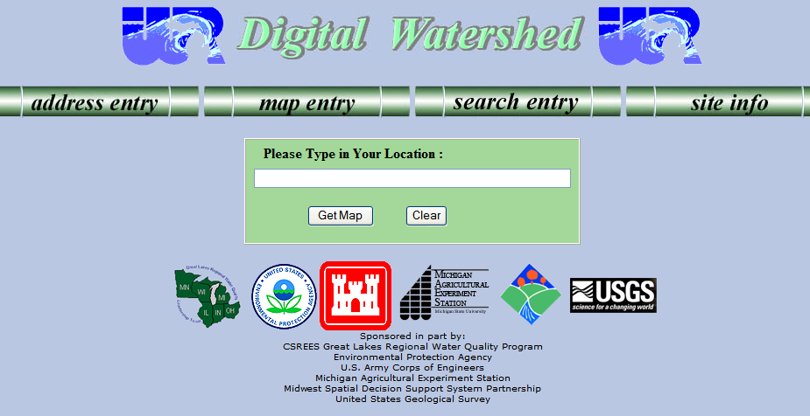
Digital Watershed www.iwr.msu.edu/dw
Notes:
11
DW is accessed at www.iwr.msu.edu/dw
It will bring up the home search page to select your watershed of interest
The default search method allows you to type in an address for watershed selection
Otherwise, you can select a watershed using a map of the U.S. (with EPA regions) or by searching for a watershed by state, name or HUC
NOTE: only one watershed can be selected at a time. You can have multiple DW maps open for different watersheds, but only the watershed you select will be manipulated in the map.

Slide 12
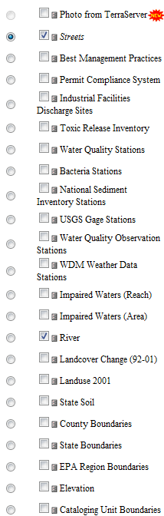
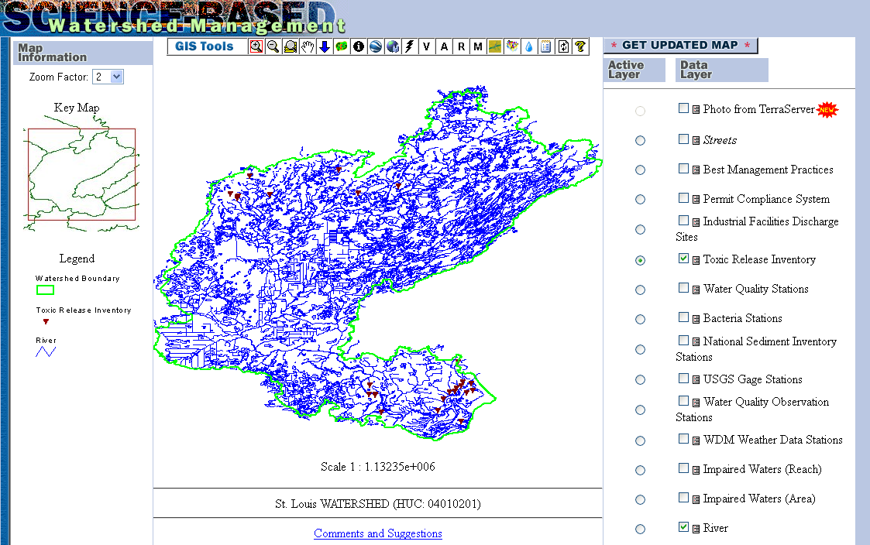
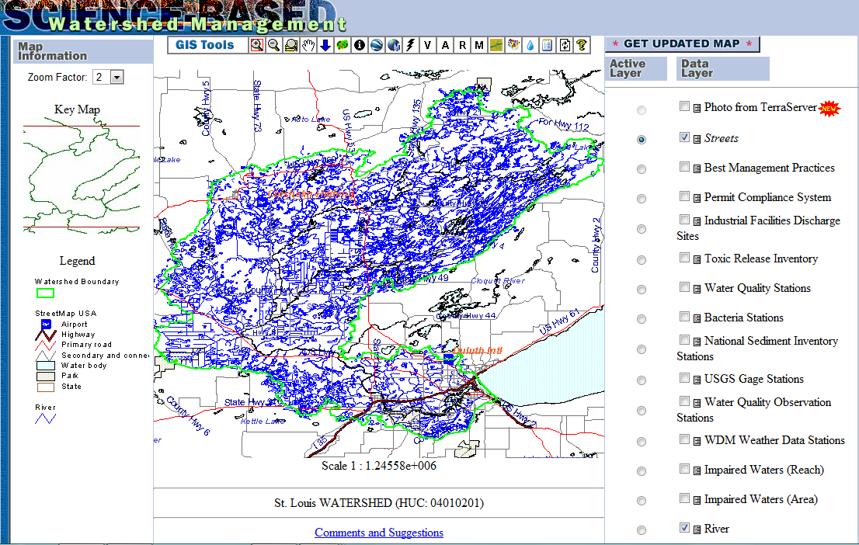
Digital Watershed: Mapping Interface
Notes:
12
Once you have your watershed selected, the mapping interface for DW will open in a new window.
Note the location of the:
Map
Legend
Layers: It’s an extensive list, many of which come from the EPA BASINS database. Some layers may not be available in every watershed (e.g. River Raisin has a CREP BMP layer created for a special project). Metadata can be accessed by clicking on the small icon in between the checkbox and the layer heading. The Streets and River layers are always drawn on by default. NOTE: visible layers in Digital Watershed are NOT updated automatically. You MUST hit “GET UPDATED MAP” or the Refresh Icon in the toolbar to have the map reflect changes you make to its layers.
Also recall the difference between active and visible layers as noted in the workshop’s factsheet. A marked circular radio button next to a layer denotes an active layer—one that can be acted on by tools like “Identify.” A checked box next to a layer signifies the layer is turned on and drawn on (aka visible) on the map.
Lastly, the toolbar at the top contains all the tools within Digital Watershed.

Slide 13
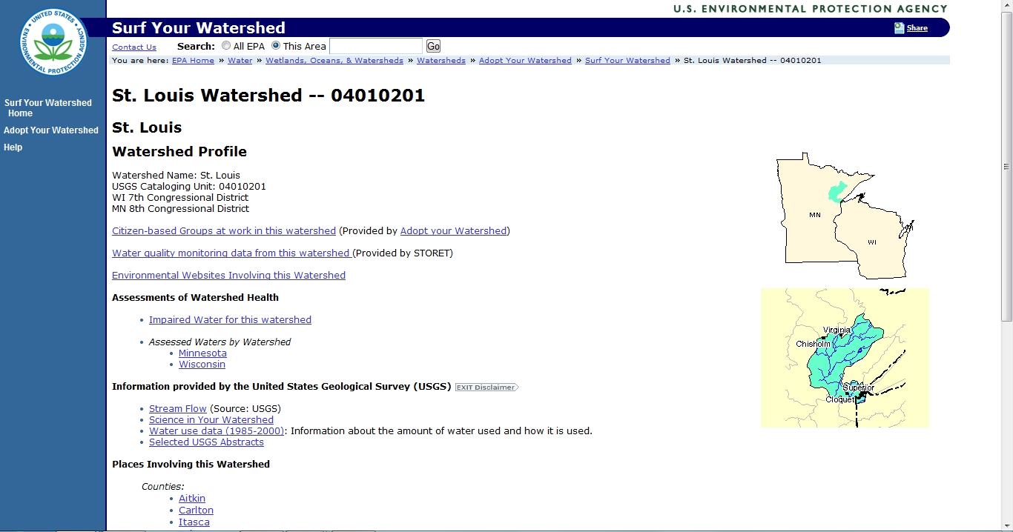
Digital Watershed: Surf Your Watershed
Notes:
The lightning bullet icon will open up the EPA’s Surf Your Watershed website for that watershed. It contains various information on the watershed, and some of this data is also directly available in DW (e.g. impaired waters). Watershed group listings, USGS stream flow and water use data, impaired waters, etc. can all be accessed from this website.

Slide 14
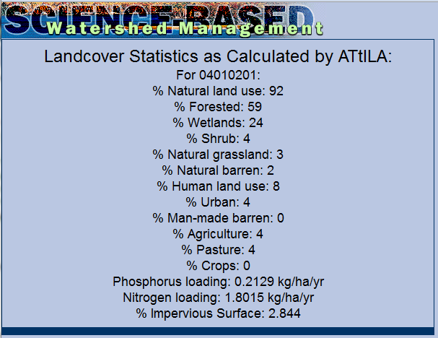
Digital Watershed: ATtILA
Notes:
The “A” icon will open up ATtILA (Analytical Tools Interface for Landscape Assessments) results. The model itself contains 4 landscape characteristic groups, but only landcover metrics, presented as percentages, are run in DW.

Slide 15
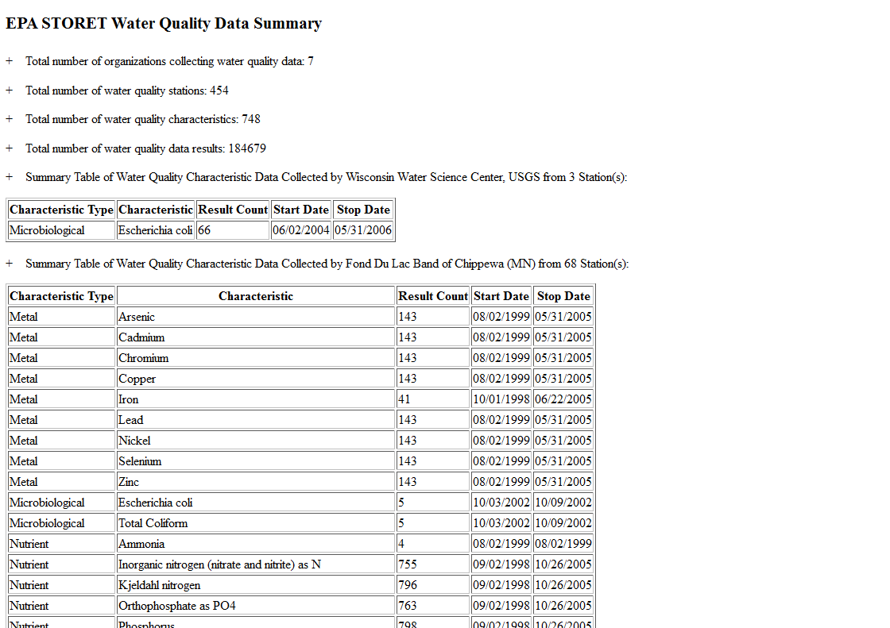
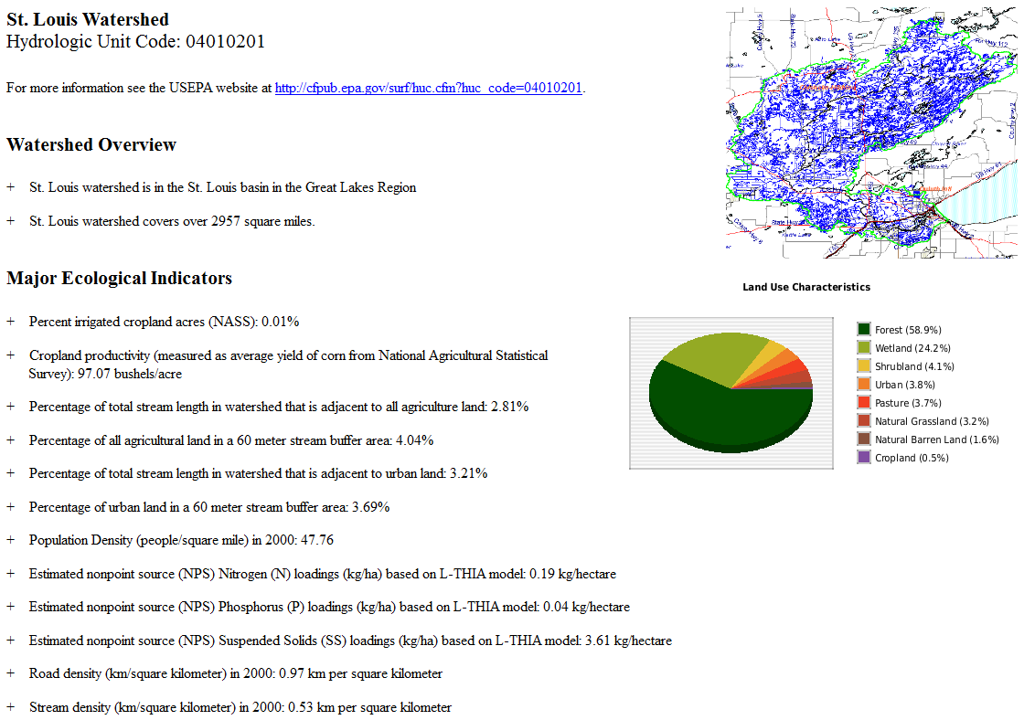
Digital Watershed: Watershed Reporting
Notes:
Clicking on the notepad icon will generate a watershed report. Watershed Reporting contains basic watershed information like square mileage, ReVa (Regional Vulnerability Assessment) indicators and WQ STORET data.

Slide 16
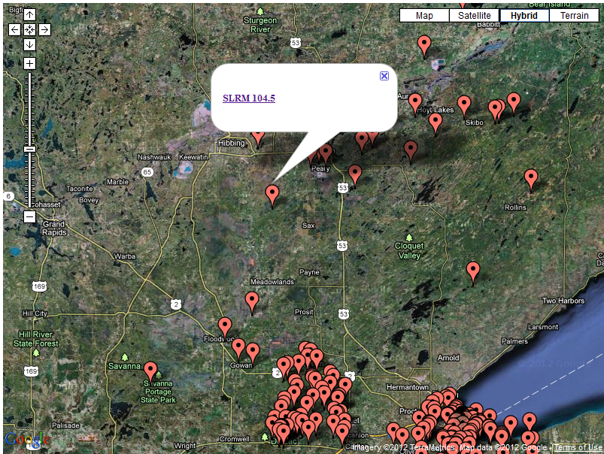
Digital Watershed: STORET
Notes:
STORET (STOrage and RETrieval) data is also accessible in a spatial format by clicking on the water droplet icon. It will bring up monitoring sites in a Google map. Each site can be clicked on to bring up a link to detailed attribute information.

Slide 17
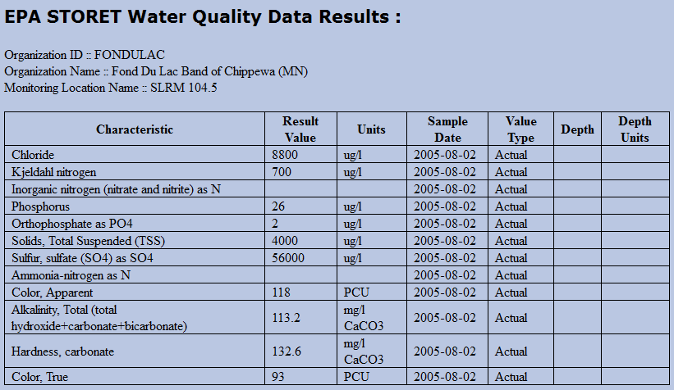
Digital Watershed: STORET
Notes:
Example attribute table

Slide 18
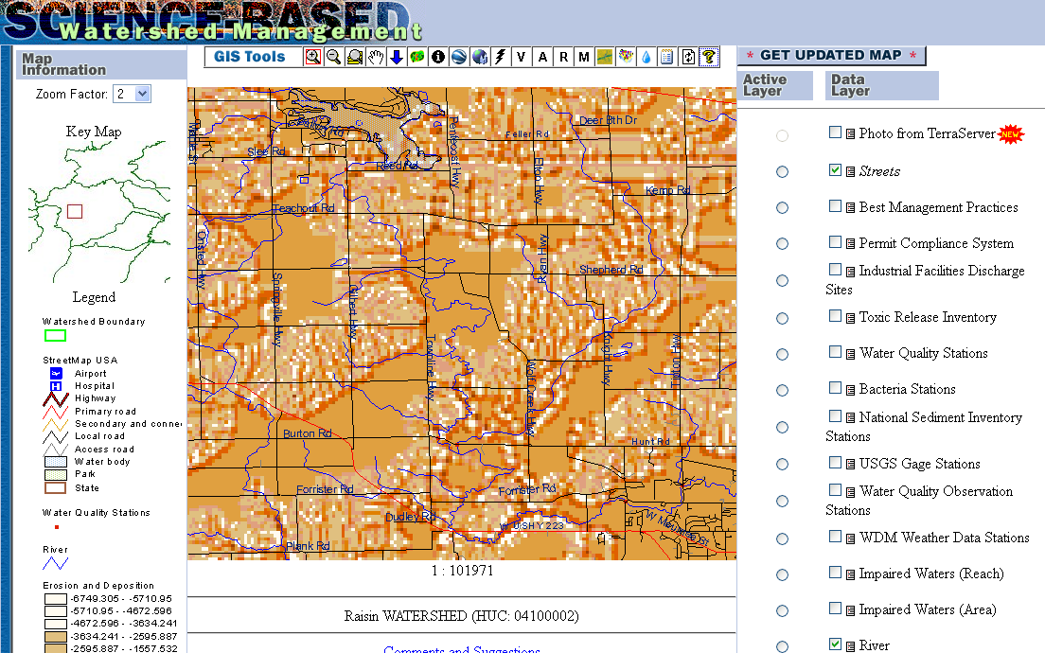
Digital Watershed: USPED Modeling
Notes:
Clicking on the “M” model will bring up results from the USPED model. The USPED model (Unit Stream Power-based Erosion and Deposition) predicts rates and distribution of land erosion and sediment deposited to receiving waters. Whiter areas indicate areas of erosion, and dark orange areas indicate areas of deposition. Note that this model is not running dynamically within DW, and was created offline.

Slide 19
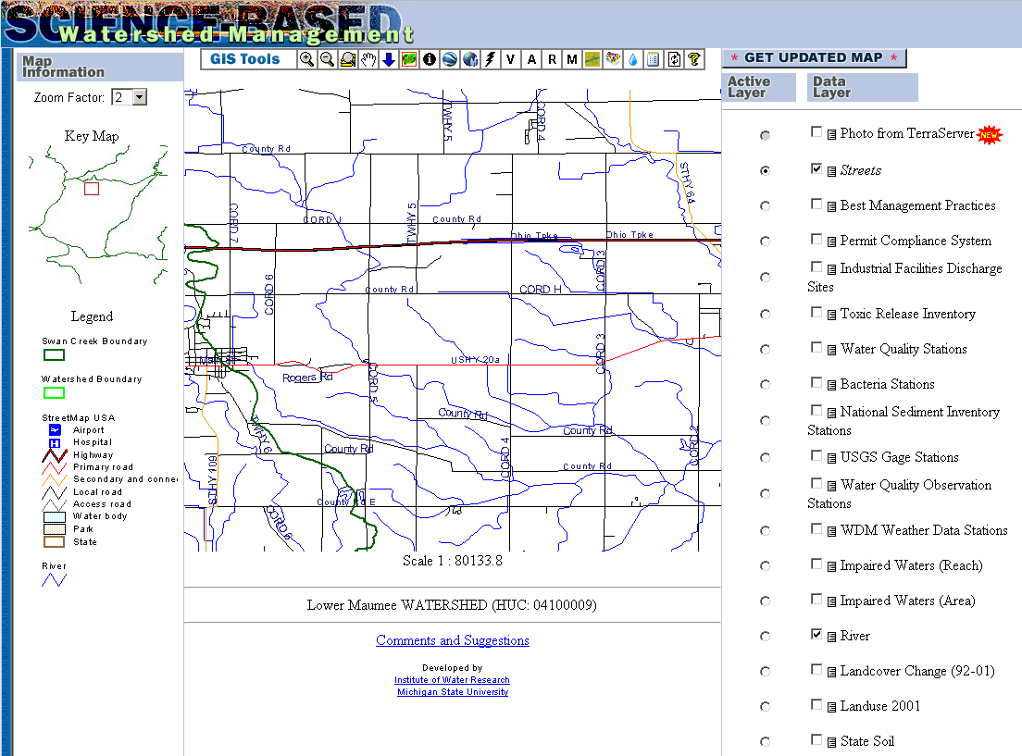
Digital Watershed: Delineate a Watershed
Notes:
Clicking on the watershed icon (essentially, the green blob) will allow users to delineate a watershed for a particular location and run Purdue University’s L-THIA model. The watershed delineation is a dynamic process, and once a point is selected, needed information to run L-THIA (land use and hydrologic soil groups) are collected. A new page will open with results (go to next slide).

Slide 20
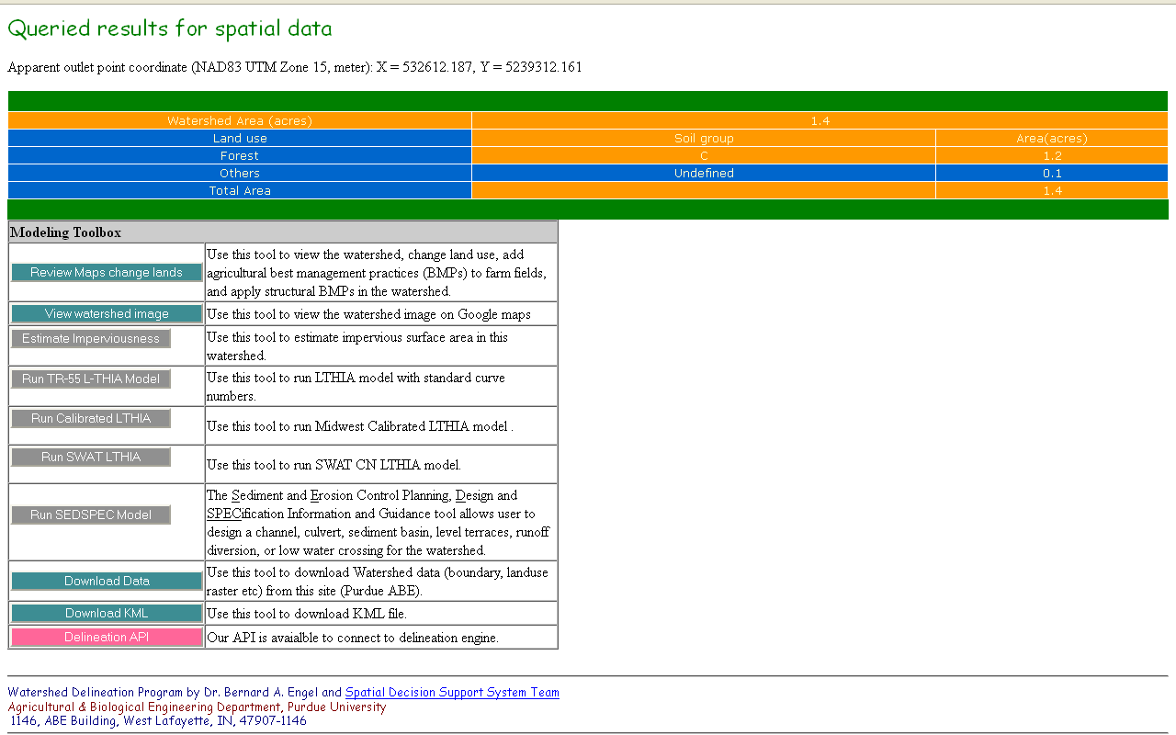
Digital Watershed: Delineate a Watershed
Notes:
Watershed delineation result. From here, you can select the desired L-THIA model to run.

Slide 21
Digital Watershed: Additional Tools
Scale-down to 12-digit HUCs
3D watershed visualization
View watershed on Google or Bing mapping platform
Create map images
Notes:
There are a few other tools as well. You can:
Scale-down to 12-digit watersheds (Arrow icon)
Get a 3D visualization of a watershed (“V” icon)
View the watershed in Google or Bing Maps—but you can’t actually run tools here. It just shows the watershed boundary within these mapping platforms (Google Earth or Bing Maps icons)
Create map images from DW—brings up an image of only the map and legend in a new window which can be saved/added to reports.
Note the “R” tool is intended to run ReVa indicators, but currently there is an issue with the EPA’s server and the tool does not work. ReVa indicators can still be accessed in the watershed reporting tool.

Slide 22


Tool Icons
Scale-down to 12-digit HUCs
3D watershed visualization
View watershed on Google or Bing mapping platform
Create map images
EPA Surf Your Watershed
Delineate a watershed
USPED model
STORET
ATtILA
Watershed Reporting
Notes:
A table with all the icons and names of tools, if needed.

Slide 23
Digital Watershed
High Impact targeting long-term hydrologic impact assessment lid
Overview
Notes:
An on-line tool to efficiently target erosion and sedimentation conservation practices in agricultural areas.

Slide 24
HIT: Background
Combination of SEDMOD + RUSLE
IWR + USACE applied HIT to GL Basin, coarse resolution
IWR refined HIT through USACE + NRCS support
Produced refined and web-accessible HIT model for GL Basin
Enhancing HIT for dynamic field-scale analysis
1999
2005
2007-09
2010
Ongoing
Notes:
Combined SEDMOD and RULSE—discussed next slide
HIT’s development began in 2001, when IWR partnered with the U.S. Army Corps of Engineers (USACE) to help reduce USACE’s dredging responsibilities in Great Lakes channels and harbors. IWR combined soil erosion and sediment delivery models to estimate sediment contributions to Great Lakes tributaries, and identify the most likely upland source areas. The principle outcome of this effort was an estimate of annual sediment loading for every 8-digit watershed (hydrologic unit code 8 – HUC8) in the basin (Ouyang et al. 2005). These estimates allowed USACE to begin targeting sediment reduction efforts at a macro-scale. However, to accommodate the broad geographic scope of the analysis, IWR had to generate these sediment estimates at very coarse resolutions of 90m². With continued USACE support, and through an NRCS Conservation Innovation Grant (CIG), IWR refined this initial effort and produced basin-wide estimates at minimum 30m² resolutions and developed a website to provide decision-support capabilities to users at federal, state, and local scales (O’Neil 2009).
IWR continues to refine HIT by developing finer-resolution models on a watershed-by-watershed project basis, incorporating new and richer model inputs, improving model processing time, and enabling dynamic web-based scenario modeling.

Slide 25
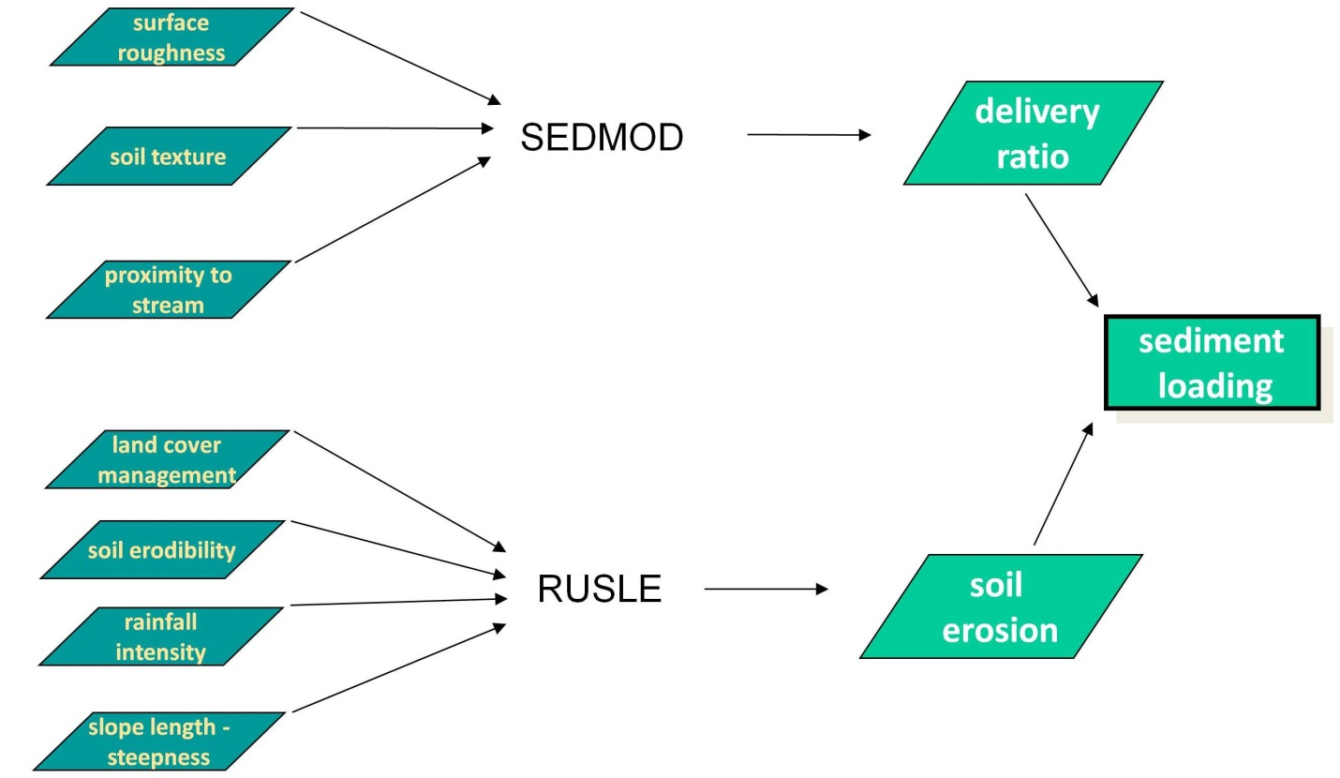
HIT Model
Notes:
For less technical audiences
SEDMOD (Fraser. May 1999)
RUSLE (Renard, Foster, Weesies, McCool, Yoder. 1996.)
The HIT tool starts with modeling. The HIT model is relatively simple, with a small number of inputs. Its simplicity makes it easier to run the model in multiple locations, but also limits the data output. HIT is the product of two models, RUSLE, which estimates soil erosion, and SEDOMD, which estimates the delivery of eroded soil to the stream network. This is done within a GIS grid, or raster, environment which allows us to come up with an estimate of sediment loading for each 100 square meter or 900 square meter (depending on the resolution of available data).
Factors within SEDMOD: Surface Roughness (Manning’s n), Soil Texture, Distance to Streams; all are weighted
Factors within RUSLE: LS (slope), C (tillage practice), K (soil erodibility), R (Rainfall), P (conservation practice)

Slide 26
HIT Model
SEDMOD¹
Land Cover
Surface
Roughness
Delivery
Ratio
Soil Clay
Content
Soil
Texture
Weighting
DEM
Distance to
Stream
Sediment
Yield
LS Factor
Landuse/Tillage
C Factor
Soil Erodibility
K Factor
Soil
Erosion
Rainfall
R Factor
Support
Practice
P Factor
RUSLE²
Fraser. May 1999
Renard, Foster, Weesies, McCool, Yoder. 1996.
Notes:
The HIT tool starts with modeling. The HIT model is relatively simple, with a small number of inputs. Its simplicity makes it easier to run the model in multiple locations, but also limits the data output. HIT is the product of two models, RUSLE, which estimates soil erosion, and SEDOMD, which estimates the delivery of eroded soil to the stream network. This is done within a GIS grid, or raster, environment which allows us to come up with an estimate of sediment loading for each 100 square meter or 900 square meter (depending on the resolution of available data).

Slide 27
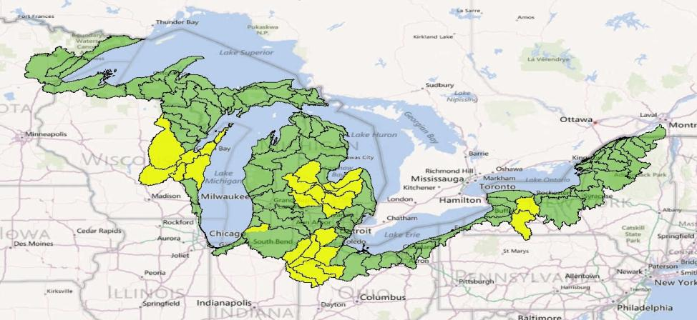
HIT: Resolutions
10-meter, available by end of 2012
30-meter
Notes:
10-meter resolution HIT model availability (yellow) by the end of 2012, 30-meter resolutions (green).
10 meter areas define GLRI priority watersheds: Fox, Saginaw, Maumee, Genesee

Slide 28
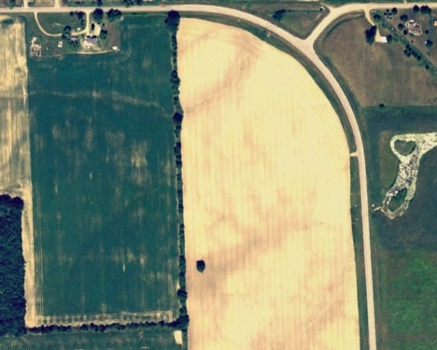
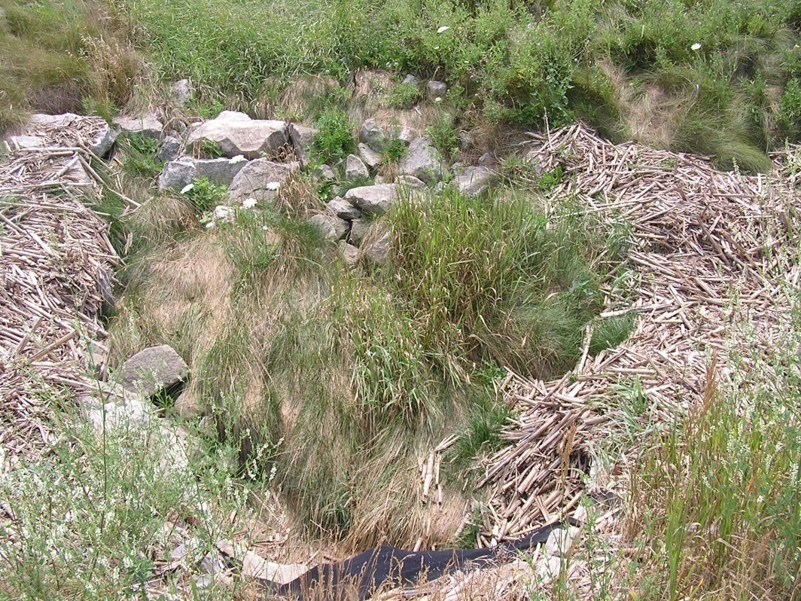
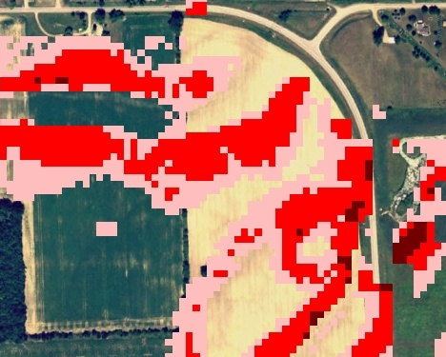
HIT: Spatially exploring areas at high-risk for sediment loading
A site in the Maple River Watershed:
0.2 – 0.4 tons/acre
0.4 – 0.8 tons/acre
Corn residue runoff in ditch.
> 0.8 tons/acre
Notes:
Once a sub-watershed has been targeted, the next question is where within the watershed should be targeted. Since the HIT analysis is spatially explicit, we can identify raster cells with higher values for sediment loading. Thus enabling a group like the Clinton County conservation district to prioritize efforts at a macro scale (sub-watersheds) and the micro scale (fields), which they did in the development of their recent 319 plan.

Slide 29
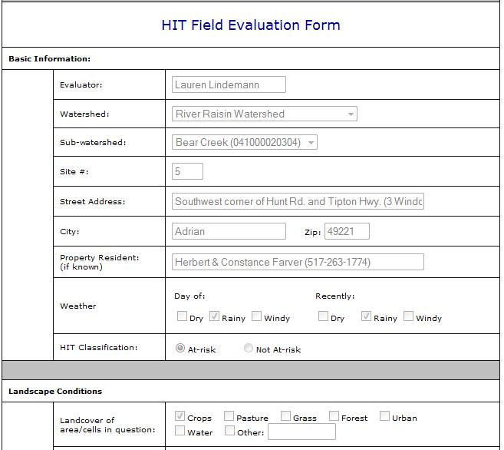
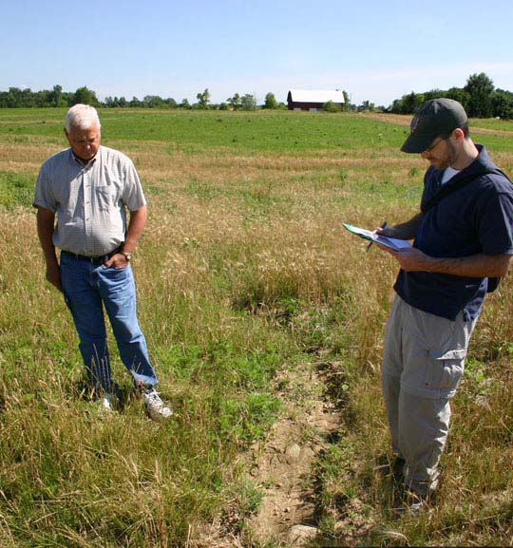
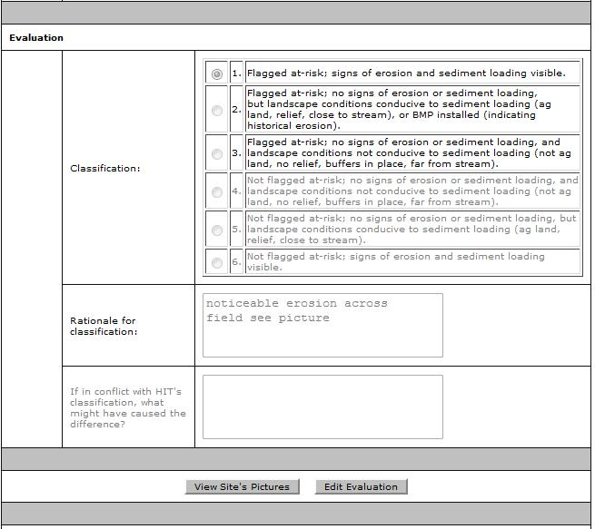
HIT: Field Evaluations
The C.D. technicians visited over 200 fields in the pilot watersheds and evaluated the accuracy of the high-risk maps.
Notes:
The technicians visited over 200 fields across the three pilot watersheds and assessed how well HIT was evaluating those fields. They printed high-risk maps from Digital Watershed, visited the selected sites, and filled out an on-line evaluation form IWR developed.

Slide 30
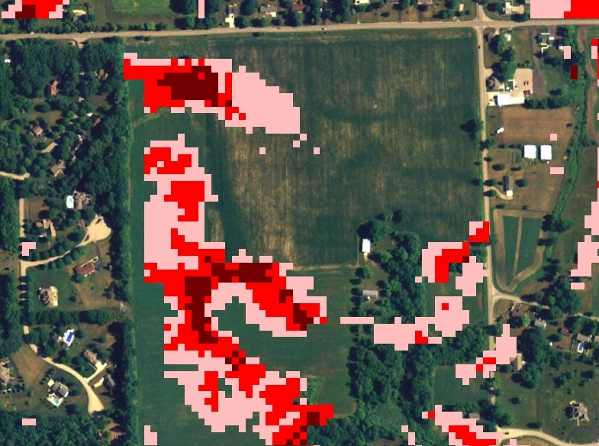
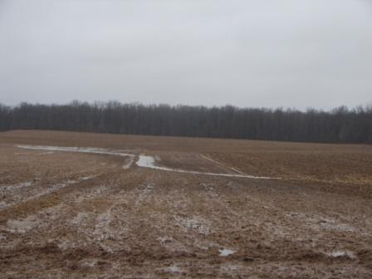
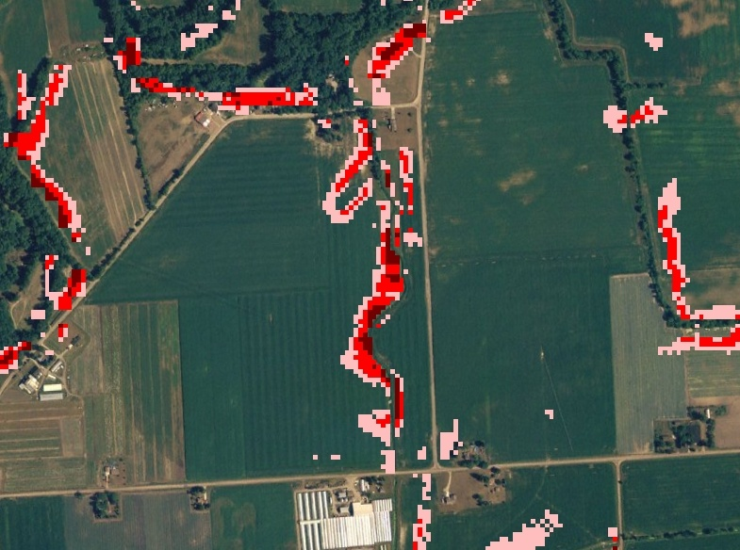
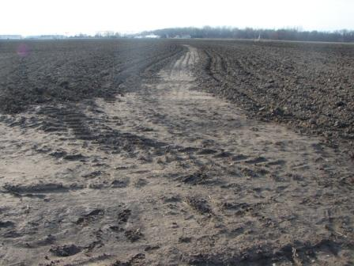
HIT: Field Evaluations
Results: 70% of the time HIT maps correctly characterized the landscape.
Notes:
The results showed that roughly 70% of the time HIT had correctly characterized the landscape. Here are some examples.

Slide 31
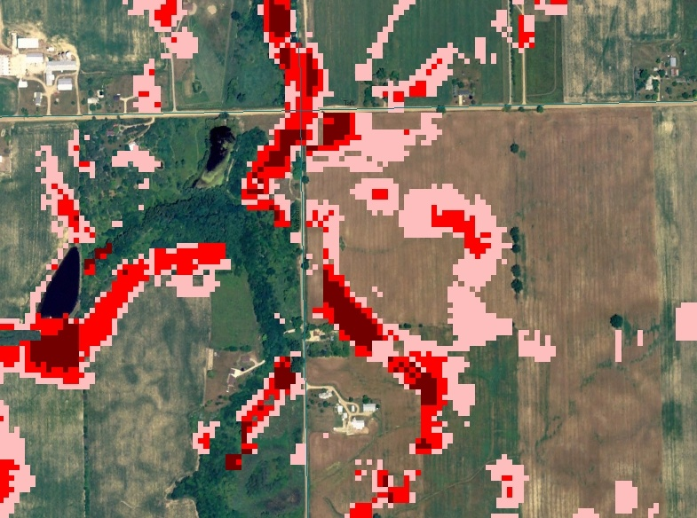
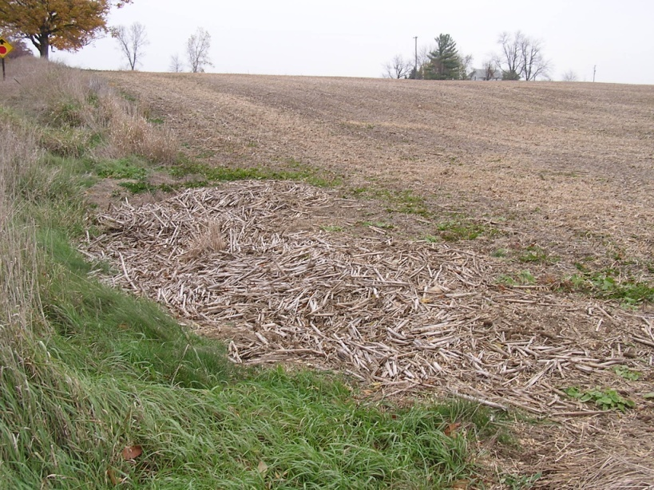
HIT: Field Evaluations
Primary causes of errors at other 30%:
- Coarse land cover input (30-meter resolution)
- DEM unable to accurately characterize flow-direction
Notes:
Of course, I cherry-picked some of the better locations and pictures to show here. We did explore the 30% of misses to try and determine why HIT erred. Coarse land-cover was the primary reason for most of these misses. The landcover input was NLCD (30-meter) which is fine for characterizing farm fields; we can be fairly confident that the cells in the middle of the field are correctly characterized as agriculture. The problem arises when the ag-land cells abut road cells. It may say that a road is 30 meters wide and is immediately adjacent to agriculture. This leaves out the drainage ditch between the road and field, which is the key geographic feature in the scene. Another problem, is that in flatter locations it can be hard for a DEM to accurately represent flow-direction. Our models may have predicted flow from a field heading east, when in fact it was heading west. Therefore our efforts to locate gullies on the fields eastern edge proved fruitless.

Slide 32
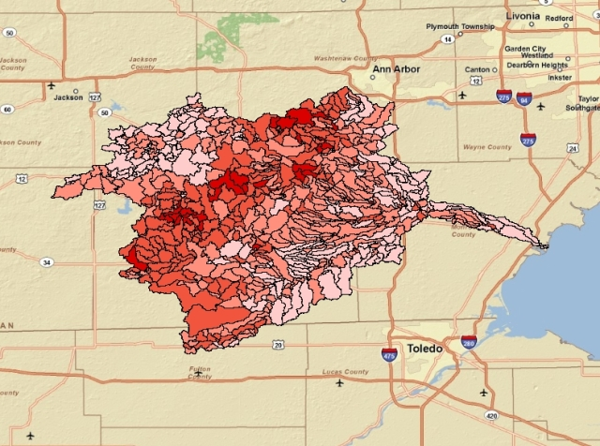
HIT: Stream Monitoring
Conservation Districts are currently evaluating HIT sediment estimates.
NHD Plus catchments (average size 700 acres) were ranked by sediment loading through HIT.
C.D. Technicians took samples during weather events from a small subset of catchments (< 15) and sent them to Michigan DEQ for analysis.
- HIT estimates and DEQ measurements of TSS were not positively correlated. Perhaps due to small sample size and HIT’s inability to model in-stream processes.
NHD Plus catchments of the River Raisin Watershed
Notes:
So the field evaluations were an assessment of one aspect of HIT, the spatially explicit high-risk maps. MDA and the technicians are also evaluating HIT ranking of sub-watersheds by sediment loading. We used HIT to estimate sediment loading at the NHD Plus catchment scale (average size of 700 acres). The technicians each selected 10 catchments to sample. They waited for rain, and gathered samples from each location. They did this for 5 different rain events. They shipped their samples to MDA, who is currently working with Michigan DEQ to analyze the samples. Once the results come back, IWR will perform a Spearman Rank correlation to see how well HIT ranked the catchments. Note, we’re not going to statistically analyze the exact measurements of sediment, but just the ranks. I’ll come back to this in a moment.

Slide 33
HIT: Limitations
Focused primarily on agricultural lands, not suitable for urban analysis.
Focused on sheet erosion (RUSLE), not gully, bank, or wind.
Comparisons to stream monitoring data have been inconclusive.
Estimates of erosion and sediment loadings are for relative comparisons of watersheds, are not intended for precision.
Notes:
If you were looking at Toledo using the HIT model, it would predict a low sediment contribution from the area. This is probably true, but should not imply that Toledo does not contribute nutrients to the Maumee. RUSLE isn’t going to help you in downtown Toledo, unless green roofing starts to kick in. There are models out there that allow for urban analysis, such as L-THIA from Purdue University, which we have actually begun to interface with in other projects. RUSLE only measures one form of erosion, sheet. It’s estimates do not include sediments from gully erosion, bank erosion, or wind erosion; which can be significant sources depending on the location. This is why we recommend the use of HIT estimates of sediment loading at a watershed scale for relative comparisons only. It’s probable that any HIT estimate of sediment loading for a watershed is below the actual amount. But this does not limit a users ability to utilize HIT to target practices within a watershed. Even though the raw numbers may not quantify gully erosion, the field evaluations have shown that the model’s spatially explicit results can help you locate them.

Slide 34







HIT’s Use in Michigan
  Conservation districts are using HIT to prioritize efforts
  MDEQ is promoting its use in 319 Watershed Planning Grants
  Clinton C.D. and consultants have used it in Maple River 319 plan.
  NRCS is factoring HIT prioritizations into EQIP application scoring
  HIT data is being viewed within the NRCS Toolkit, integrating HIT into the workflow of conservation technicians.
Notes:
Clinton, Huron and Lenawee CDs were the preliminary testers of HIT.

Slide 35
Digital Watershed
High Impact targeting long-term hydrologic impact assessment lid
Walkthrough

Slide 36
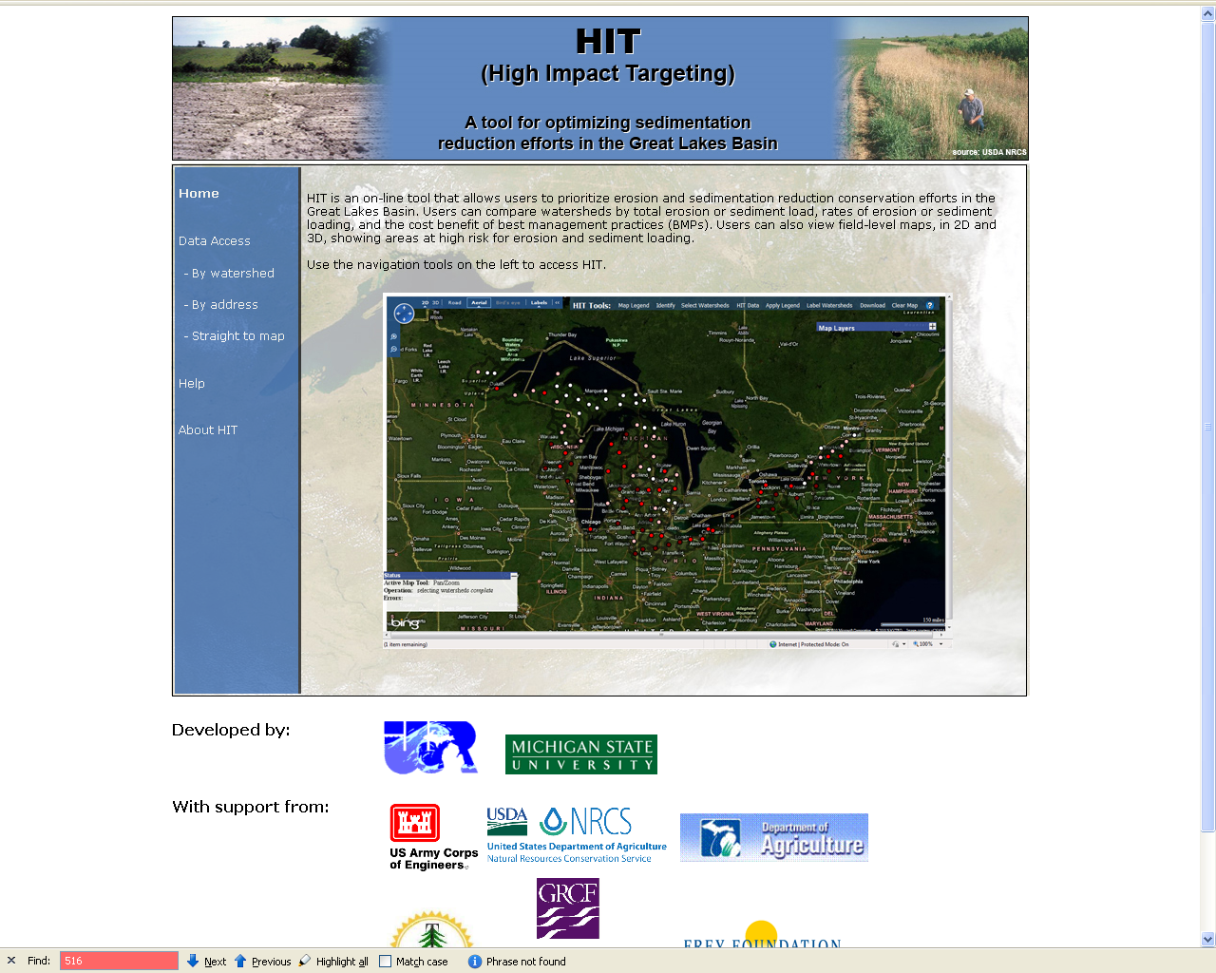
www.iwr.msu.edu/hit2
Notes:
HIT’s homepage.
Note the “Data Access” heading. “By watershed” lets you select watershed(s) from menus, “By address” let’s you select 1 watershed, “Straight to Map” takes you straight to the map without selecting any watersheds.
Help has some links to tutorials. About HIT has brochures and presentations available for download.

Slide 37
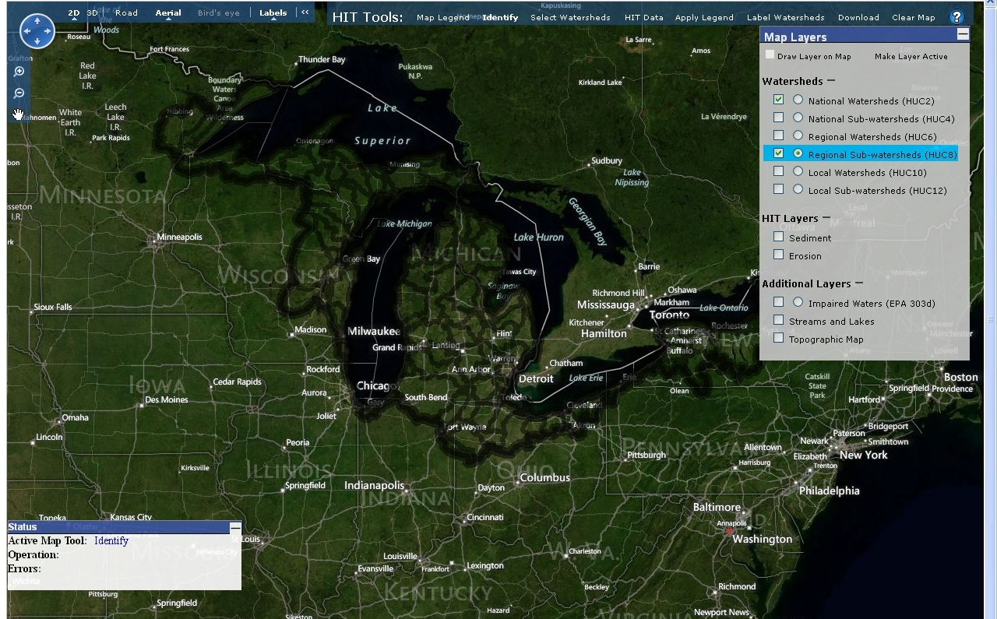
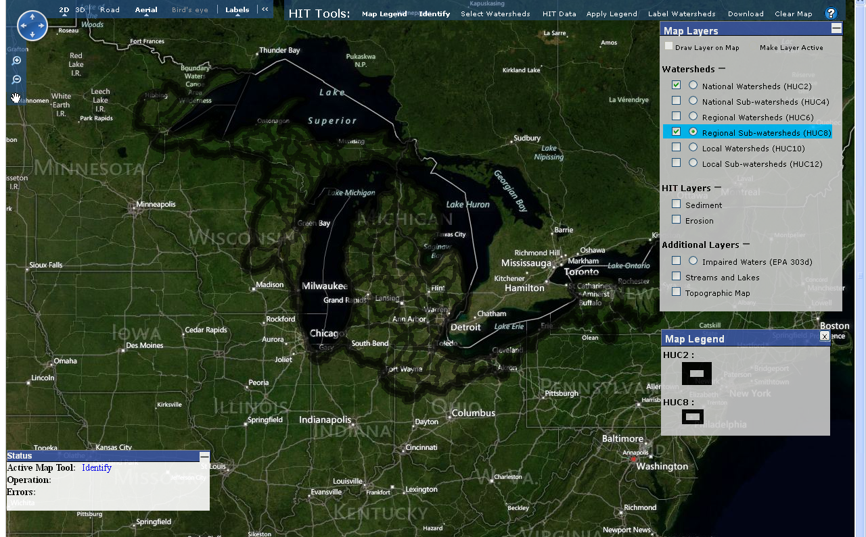
HIT: Mapping Interface
- Built on Microsoft Bing Maps
- Available for the entire Great Lakes Basin
- Allows for analysis at all watershed scales
Notes:
HIT 2.0 is built on Microsoft’s Bing Maps (Used to be Live Maps, but MS inexplicably renamed it Bing, to go along with its new search engine – But It’s Not Google). HIT 2.0 allows for analysis across the Great Lakes Basin. Note: I understand that we’re leaving out Canada, but thus far the data necessary for modeling has only been readily available for the U.S. side. And allows for analysis at all watershed scales, 2-digit through 12.
Note the “Map Layers” menu. Here is where users can adjust what’s visible on the map, and which layer is active. Again recall the differences between active layers and visible layers. Checked boxes mean the layer is drawn on the map (visible). The circular radio buttons are to mark an active layer– only one layer can be active but multiple layers can be visible. In order to select a watershed within the map, use “Identify,” “HIT Data,” “Label Watersheds,” “Apply Legend,” etc., one of the HUC layers MUST be activated. In this example, the HUC8 and HUC2 layers are drawn on the map, and the HUC8 is currently active.
Next, notice “HIT Tools” at the top. As you work with the HIT model, these tools will be very important in your analyses. More on these later.
The toolbar anchored in the left-hand corner is for Bing Maps. You can choose between different displays (2D and 3D), map backgrounds (Aerial, Bird’s Eye, Road), and turn on/off map labels.
A map legend can be accessed by clicking “Map Legend” from the toolbar. It will automatically update as you adjust which layers are drawn on the map.
Notice the “Status” box in the bottom left corner. This indicates which map tools are active. Right now, the “Identify” tool is active.
Further notice that “Identify” and “Map Legend” are in bold on the toolbar. This means that you are currently working with these tools. Headings not in bold indicate that those tools are not being used.

Slide 38
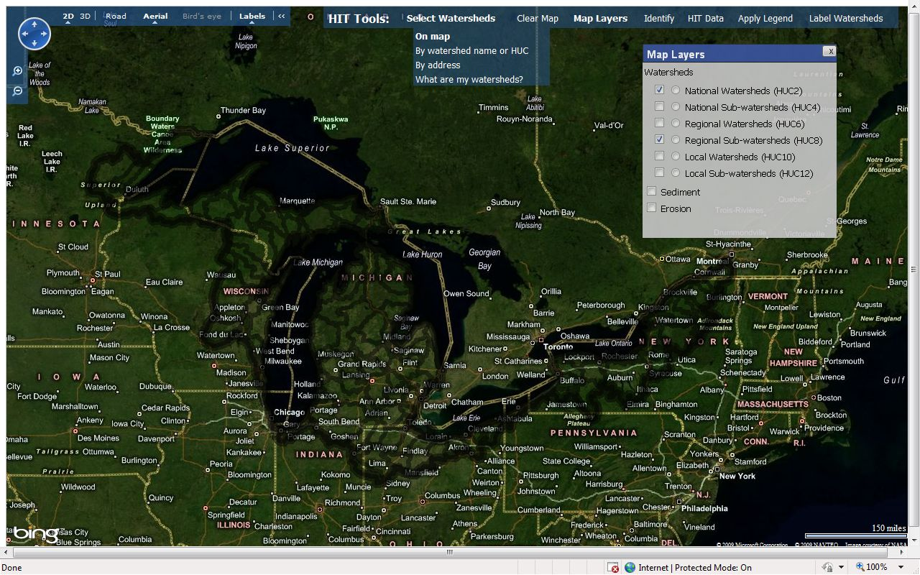
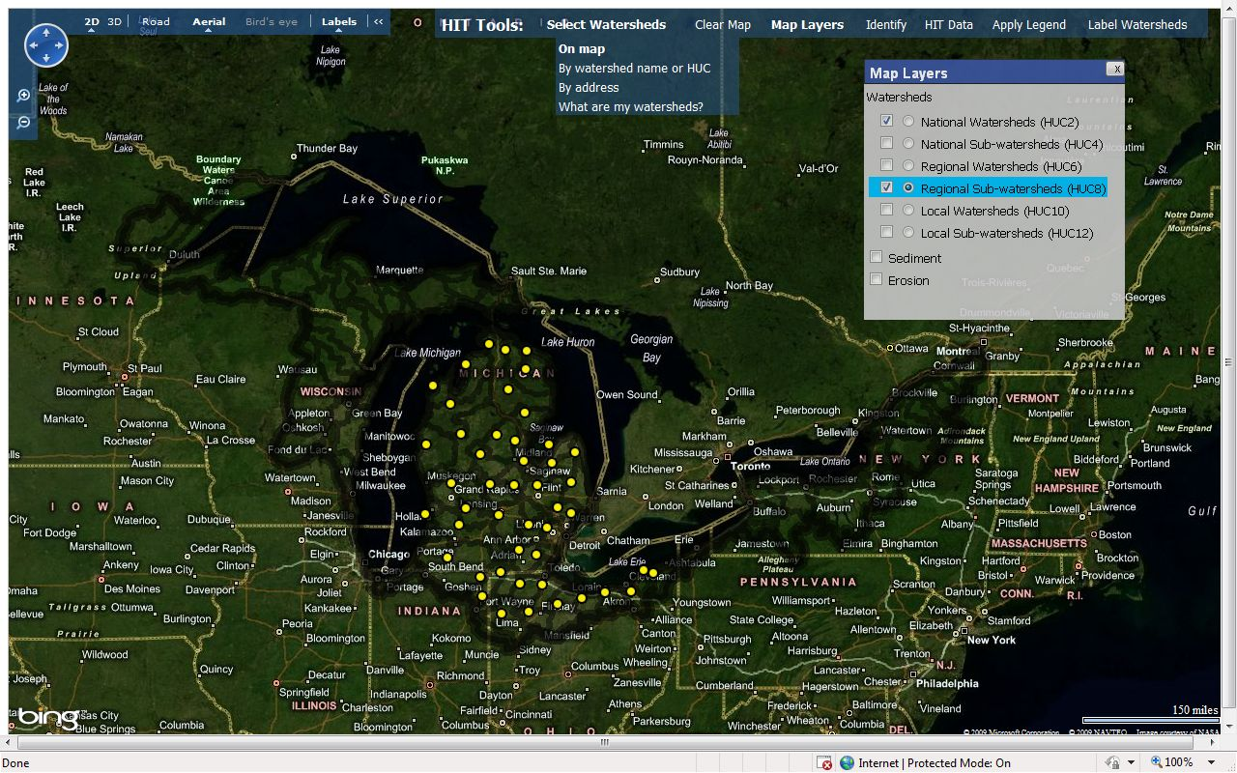
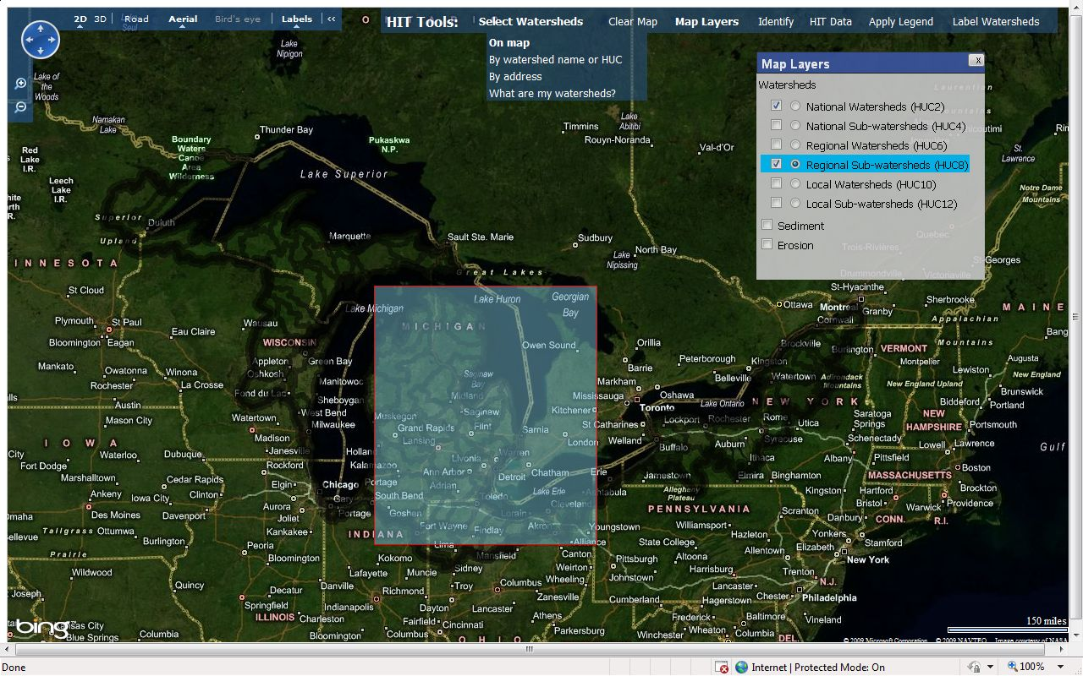
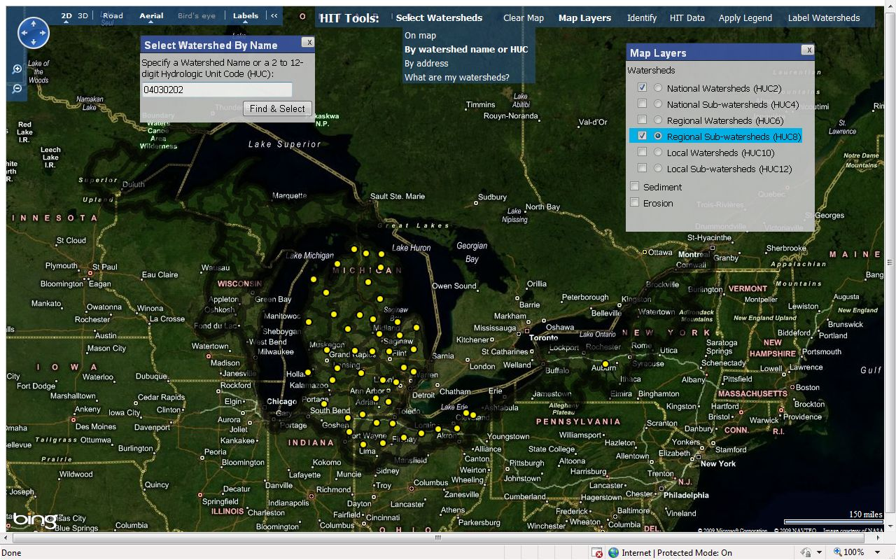


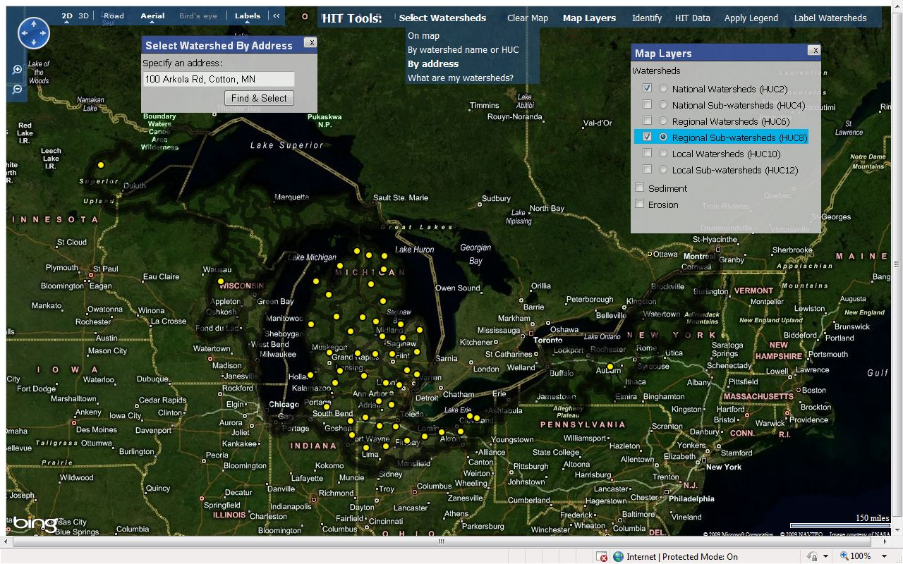
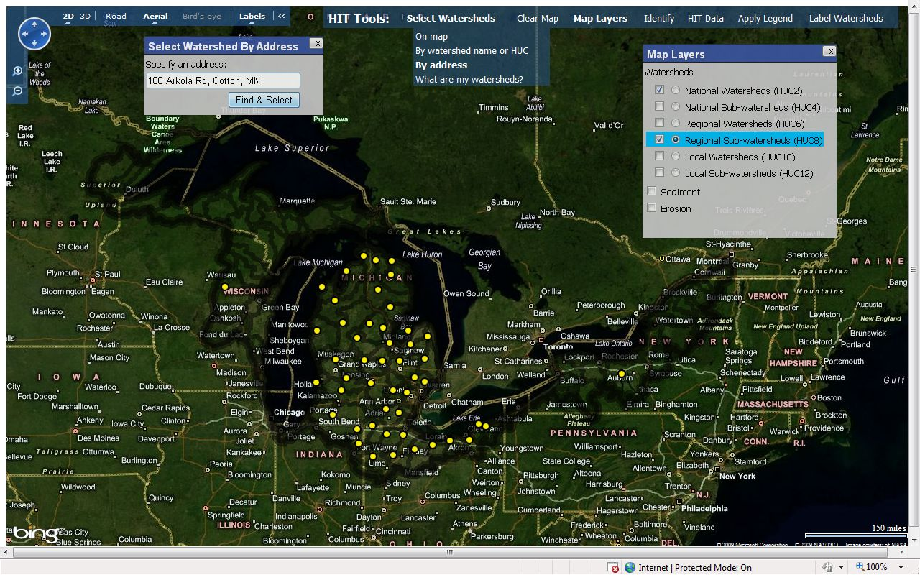

HIT: Selecting watersheds
Select watersheds for analysis spatially, by name, HUC, or address.
Notes:
38
Again, in order to select a watershed, one of the HUC layers must be active. You can select layers directly on the map (draw a box or click individually on watersheds), by typing in the watershed name or HUC, or by providing an address.

Slide 39
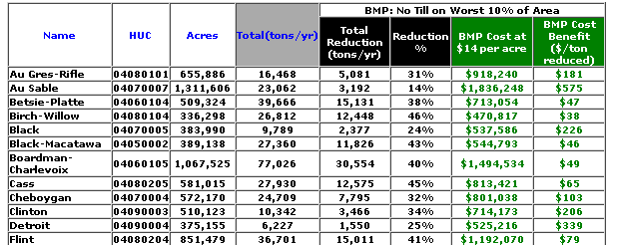
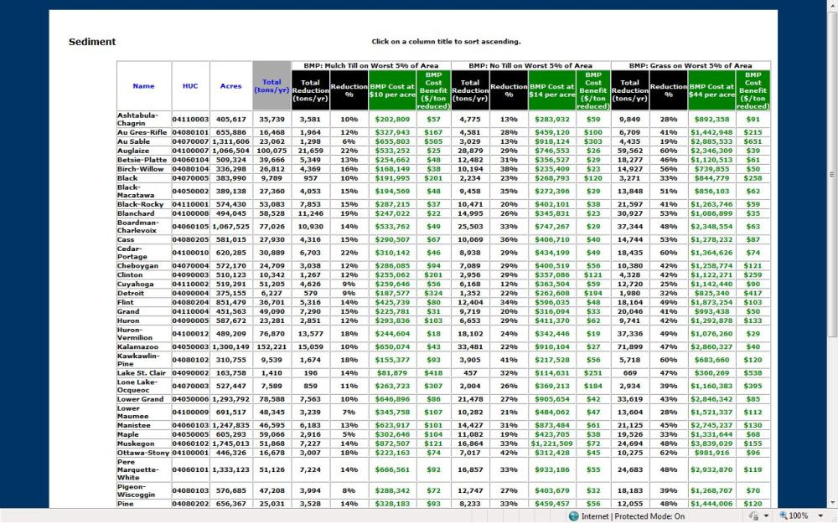
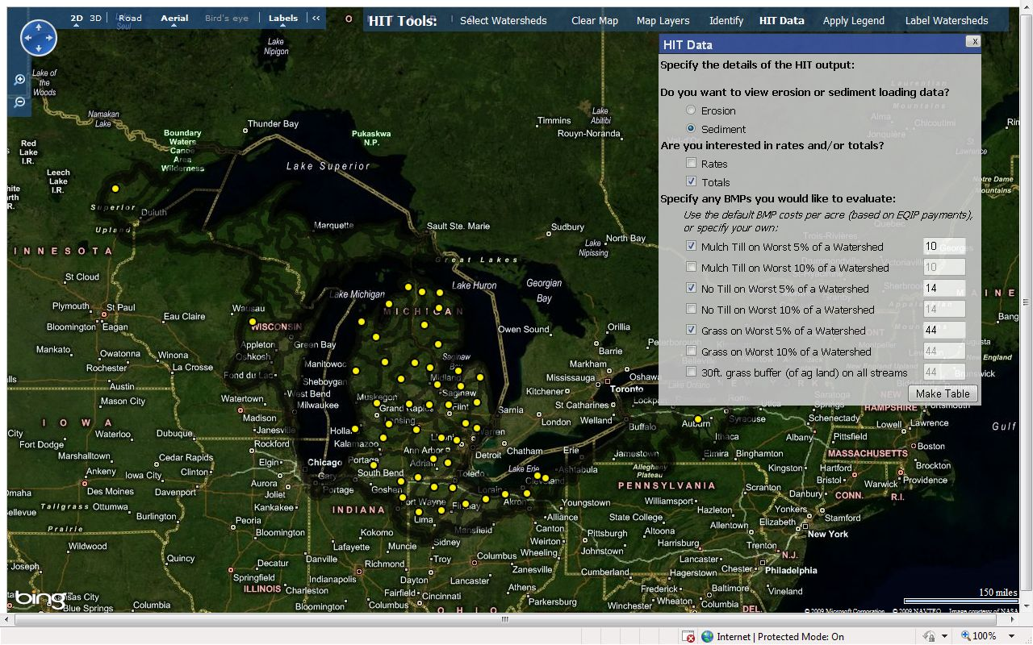


HIT: Tables
HIT tables can be generated as in the original system.
Notes:
39
HIT tables provide valuable information for prioritization. Remember that these are ESTIMATES and should be used to make relative comparisons between watersheds or BMP scenarios.
Choose between Sediment or Erosion, Rates or Totals, and various BMP scenarios. Note that BMP scenarios do not need to be selected to create a HIT Table. Also note that HIT tables can be made from the other watershed selection methods on the HIT homepage.
The first three white columns display basic watershed information: name, HUC, acres.
Grey columns indicate either total sediment load or rate of sediment loading.
The black columns show the estimated reduction in sediment loading for each BMP.
The green columns show the cost-benefit ($ per ton of sediment loading reduced) of each BMP, essentially the “bang for the buck” number.
Costs for BMPs can be adjusted and recalculated on the fly. Columns can also be sorted by clicking on a column’s heading.

Slide 40


HIT watershed prioritization
Least loading per acre
Less loading per acre
More loading per acre
Watersheds can be shaded by erosion or sediment data.
Most loading per acre
Notes:
40
A quick way to visually see watersheds at higher risk for erosion/sediment is using the “Apply Legend” tool. It lets you shade watersheds by sediment/erosion and rates/totals. There are two different ways to classify the data: equal intervals or quartiles.
“Equal Intervals” defines bins for the watersheds using value ranges of equal size (e.g. 0-2, 2-4, 4-6, 6-8), while “Quartile” creates value ranges for the bins so that each bin has roughly the same number of watersheds. Quartiles typically produce the more cartographically appealing map, as Equal Intervals can be skewed by very large values relative to the rest of the sample.

Slide 41




HIT watershed prioritization
Least loading per acre
Less loading per acre
More loading per acre
Most loading per acre
Watersheds can be shaded by erosion or sediment data, at multiple scales.
Notes:
You can use “Apply Legend” at various HUC scales.

Slide 42




HIT field prioritization
Improved aerial imagery allows for richer field-level analysis.
Notes:
42
Bing Maps has various ways to help see high-risk areas up close. You can zoom in on fields with the Sediment or Erosion layers drawn on the map, view the map in 3D, or use “Bird’s eye” to see very detailed aerial imagery. This imagery can help you discern areas that seem to have channelized flow on their fields or spot areas that have BMPs already installed (ie grassed waterways). Note that Bird’s eye imagery may not be available in all locations.

Slide 43
Digital Watershed
High Impact targeting long-term hydrologic impact assessment lid
Tutorial
Notes:
Pull up PDF for appropriate tutorial

Slide 44
Web-based Watershed Management Tools for 516(e)
Train the Trainer Workshop
June 21, 2012
L-THIA LID Component
Bernie Engel, Larry Theller
Youn Shik Park, Tim Wright

Slide 45
Digital Watershed
High Impact targeting long-term hydrologic impact assessment lid
Web-based Low Impact Development Decision Support and Planning Tool
Overview:
Basic Curve Number Analysis
The L-THIA LID Model
What is Low Impact Development
Specific LID Practices

Slide 46
Tutorial Outcomes
User will employ L-THIA LID model to estimate environmental benefits for various LID practices
User will be able to estimate costs of potential “Lot Level” LID practices

Slide 47


Slide 48


Impact on Hydrology
Pre-development
Post-development

Slide 49
Impact on Hydrology
Eventually, “increase” in
  Peak flow
  Direct runoff
after urbanization
Urbanized Area
Direct Runoff (Volume)
Detention basin
Natural
Time

Slide 50
Basic L-THIA Model
Long-Term Hydrologic Impact Assessment
  Average annual runoff
  NPS pollution
An overview / screening model
User friendly tool
Does not require detailed data input
Identifies need for more detailed modeling
Provides "What-If" alternatives evaluation

Slide 51
Assumptions
Water flows across the surface to form watershed
  storm drains are not considered
No routing of runoff
Average antecedent moisture
  soil is not saturated or frozen
Rainfall is evenly spread in local area

Slide 52
Limitations
Accuracy of landuse and soil data
Accuracy of runoff curve number (CN)
  Depends on landuse and soil data
Accuracy of published NPS relationship
  Lead in runoff based on 1990’s models

Slide 53
Curve Number to Compute Runoff
Curve Number (CN) relationship originally described in the Soil Conservation Service publication “TR-55” (NRCS, 1986) and several modifications have since been proposed.
Relationship between rainfall, runoff and CN value is
non-linear, meaning small changes in land use or rainfall can produce large changes in runoff.
Use of CN equation in L-THIA LID is a simple alternative to more complicated hydrological models that require extensive data inputs.

Slide 54

Example Curve Numbers
Notes:
Sample curve numbers and hydrologic soil groups

Slide 55

Curve Number to Compute Runoff

Slide 56

Curve Number Analysis
rainfall to runoff ratio for different surfaces
Direct
Runoff
Rainfall (in)

Slide 57
Nonpoint Source Calculations
Coefficients called Event Mean Concentrations (EMC) used for nonpoint source (NPS) water quality calculations compiled by the Texas Natural Resource Conservation Commission (Baird and Jennings, 1996) from numerous literature and water quality data.
NPS pollutant masses computed by multiplying runoff depth for a land use by area of that land use and appropriate EMC value and converting units.
Complete list of EMC values used in L-THIA LID model available in Appendix B1.

Slide 58
Nonpoint Source Calculations
L-THIA LID Land Uses:
Commercial
Industrial
High Density Residential (1/4, 1/8 acre lots)
Low Density Residential (1/2, 1, and 2 acre lots)
Water / wetlands
Grass pasture
Agricultural
Forest

Slide 59

Nonpoint Source Calculations
EMC values for calculation of NPS contaminants from each landuse

Slide 60
Nonpoint Source Pollution
L-THIA LID produces Average Annual Pollutant Results for sediment, nutrients, a series of metals, and bacterial indicators
(e.g. lbs of Nitrogen per year)
L-THIA LID NPS Outputs:
Nitrogen | Chromium
Phosphorous | Nickel
Suspended solids | BOD (Biological Oxygen Demand)
Lead | COD (Chemical Oxygen Demand)
Copper | Oil and Grease
Zinc | Fecal Coliform
Cadmium | Fecal Strep

Slide 61
Basic Model Concepts
Model is easy to run
Always gives an output…
Important to understand assumptions and limitations
Notes:
Conclusions

Slide 62

How good is L-THIA
L-THIA estimates match measured direct runoff separated from USGS daily stream flow VERY WELL

Slide 63
L-THIA LID
Based on the rainfall – land cover – runoff analysis method already used in many communities
Input: Land Use Pattern(s) + Soils Pattern
Process: Daily Runoff and Pollutant Loading Calculations (30 years)
    Microscale CN Adjustment
Output: Average Annual Runoff and
        NPS loads

Slide 64

Model Interface

Slide 65


Model Interface

Slide 66



Model Interface

Slide 67
Low-Impact Development (LID)
Approach to land development to mimic pre-development site hydrology to:
Reduce volume of runoff
Decentralize runoff, diffusing flows into smaller retention/detention areas
Improve water quality
Encourage groundwater infiltration
Notes:
Reduce runoff = managing stormwater volume and quality, reduce flooding

Slide 68
LID Benefits
Ecologically Sensible
Provides Added Values / Ecosystem Services
Economically Sustainable
Lower Costs (Construction, Maintenance & Operation) vs. Conventional
Multifunctional Practices
Ideal for Urban Retrofit

Slide 69
LID Major Components
Conservation (Watershed and Site Level)
Minimization (Watershed and Site Level)
Integrated Management Practices (Site Level)
Conservation
  Forest/Woods
  Infiltrable Soils
Storage, Detention & Filtration
  Rain gardens
  Drainage swales
  Green roofs
  Porous Pavement
Minimization
  Reduce imperviousness
  Soil Compaction

Slide 70
L-THIA LID Basic Screening
Application: Target preliminary goals at
watershed and site level
Reduce imperviousness
Conserve infiltratable soils
Conserve functional / sensitive landscape
Minimize land disturbances
Anticipate need for other LID practices to reduce NPS and stormwater volume

Slide 71

L-THIA LID Lot Level
Low Impact Development 2010: Redefining Water in the City © 2010 ASCE
Notes:
Within L-THIA/LID “Basic”, CN is adjusted based on percent impervious and soil
type for a particular developed land-use designated by the user. The default
impervious percentage values are set for the land uses shown in Table 1 (NRCS,
1986) from the SCS curve number method. The new CN values resulting from the
'Percent Impervious Input' are generated based on interpolation of the plot of
impervious percentage versus the CN fore the land uses and hydrologic soil group
(Figure 5). The assumption is that the corresponding pervious surface for a particular
soil group is 'Grass' in 'Good' condition. A composite CN is computed for the user
specified land use and percent impervious.

Slide 72
L-THIA LID Available Practices
porous pavement (narrow or pervious)
permeable or disconnected patios/sidewalks
rain barrel/cistern
green (vegetative) roof
bioretention/rain garden
grass swale
open wooded space –soil conditions

Slide 73

LID Estimated Costs
Cost estimates (2008) for BMP construction.

Slide 74
Next: Review of LID Practices
Information sources.
Details about estimating costs of specific practices.
Design information in Appendix B3.

Slide 75

http://water.epa.gov/infrastructure/greeninfrastructure/gi_what.cfm
Notes:
Information source

Slide 76

http://en.wikipedia.org/wiki/Low-impact_development
Notes:
Information source

Slide 77

Porous or permeable pavement, sidewalks, driveways are surfaces that infiltrate, constructed from a range of materials.
Notes:
Begin porous pavement section

Slide 78
Permeable Pavement and Permeable Patio
Permeable pavements or asphalts generally used to capture and filter runoff from impervious parking lots, driveways, streets, roads, and patios, thus controlling NPS pollution loading (Dietz, 2007).
While traditional pavements turn almost all rainfall into runoff, permeable pavements encourage infiltration of rainfall by creating extra moisture in the soil profile.
Original CN value of 98 for conventional asphalt was changed to 70, 80, 85, and 87 for driveways and sidewalks with porous materials as suggested by Sample et al. (2001).

Slide 79

Porous Pavement –Lot Level
Specify width of streets and sidewalks,
Disconnection from stormwater system;
The % impervious of the parking lot pavement

Slide 80
Pavement Cost Estimate
This land use is 1/8 acre lot, high density residential.
The default assumption is 871 ft² of pavement per driveway per lot.
To cost the porous pavement option, user assumes 8 lots this size per acre.
Cost table has range of $2 to $12 per ft² of pavement.
Estimate could be $10.00 times 8 lots times 871 ft² =
$ 69680 / acre

Slide 81

http://en.wikipedia.org/wiki/Faroe_Islands.JPG
Notes:
The original, really Green Roof

Slide 82

City Hall’s Green Roof, Chicago
http://en.wikipedia.org/wiki/Chicago_City_Hall_Green_Roof.jpg
Notes:
American green rof

Slide 83
Green Roof
Green roofs have been used for many years, especially in Europe, to retain precipitation, provide insulation, and create habitats for wildlife (Miller, 1998; Rowe, 2011).
Green roofs have also been credited for lowering urban air temperature and help reduce heat island effects (Miller, 1998; Rowe, 2011).
Depending on thickness of layers used and extent of required maintenance, green roofs can be portrayed as extensive or intensive (GRRP, 2010).
Green roof was represented using value of 86 for runoff CN for the 4 HSGs (Sample et al., 2001).

Slide 84
Green Roof
Wide variation in cost and complexity
Low estimate $ 8.50 per square foot
High estimate $ 48.50 per square foot.
Next slide is an example with 28 commercial acres with 25% roof, or 7 acres of roof.
That creates 43560 * 7 = 304920 ft² feet of roof.
And this proposal is that 50% of the roof will have LID practice:
Mid-range cost of $ 29.00 ft² times 0.50 % of 304920 ft² is
$ 4.4 million.

Slide 85

Green Roof
Percent of roof treated with BMP
Total area of this landuse
Percent of area which is roof

Slide 86
Rain Barrels
Installation of rain barrels and cisterns in residential subdivisions allows harvest of rainfall water for potential reuse.
In many countries with water scarcity problems, especially in developing countries, use of vertical storage systems, tanks, and underground storage structures is a common practice and serves as good water supply reservoirs.
Value of runoff CN used to represent rain barrels is 94 and cisterns is 85 for the 4 HSGs (Sample et al., 2001).

Slide 87

L-THIA LID: Lot Level Screening Tool
For a median price barrel assume $200 each;
The model assumes one per homeowner.
High density residential 1/8 acre lot land use would require 8 barrels per acre if practice is 100%; 4 barrels /ac at 50%.
$ 1600 per acre of 1/8 acre lot residential landuse at 100% LID.
Rain Barrels may be installed by volunteers or professionals, so costs vary.

Slide 88
L-THIA LID: Lot Level Screening Tool
Application: Target preliminary goals by
adjusting lot level features
Site Design & Development preparation
  Narrowing impervious areas (sidewalks, driveways, roads)
  Natural resource preservation
  Heavy equipment use → compaction
  Permeable paving materials
  Vegetative roof systems
Bioretention cells
Vegetated swales /Filter strips
Rain barrels
Disconnect impervious areas

Slide 89
Bioretention Systems
Bioretention systems consist of shallow depressions designed for holding stormwater runoff from impervious surfaces such as parking lots, rooftops, sidewalks, and drive ways.
They promote infiltration by allowing rain water to soak into the ground, thus reducing runoff that can potentially enter stormwater systems.
Bioretention systems also support runoff filtration for water quality improvement with planted non-invasive vegetation.
Values of runoff CN used to represent hydrologic benefits of bioretention systems are 35, 51, 63, and 70 for Hydrologic Soil Group (HSG) A, B, C, and D, respectively.

Slide 90

Design of bioretention systems is very site-specific.
L-THIA LID practice is applied as a benefit (to the curve number) for the entire area.
LID size is generalized and assumed to be adequate. A typical size (for cost estimates) for a residential lot could be 100 ft².

Slide 91

Using L-THIA LID Lot Level
Reduce street width from 26ft. to 18ft.
Rain barrels for Residential
Green Roofs for Commercial
Bioretention/Raingardens
Reduces Post-developed runoff by 46%

Slide 92
Design Summary
L-THIA LID is a screening tool to evaluate benefits of LID practices
L-THIA LID provides an easy to use interface
Will enable decision makers to formulate watershed management plans to meet goals
Along with other tools, allows stakeholders to understand impacts of water quantity and quality resulting from land use change
https://engineering.purdue.edu/~lthia/

Slide 93
Accountability
Are the tools in use?
Who is using the tools?
How can they be improved?
Are browser or script issues a problem?
Is navigation clear?

Slide 94
Google Analytics
Accountability in full.
Analytics allows full tracking of traffic to site.
Goes beyond hit counts; allows resolution of location and source of traffic.

Slide 95

Google Analytics
Customizable reports mailed as PDF.

Slide 96

Google Analytics
Compare traffic patterns to outreach programs.

Slide 97
L-THIA tools : 30,000 hits in 2010.*
Swan Creek (Ohio) Tool – COE project of Michigan State IWR and Purdue
  940 visits in 2009-2010
  13 universities provided 60% of traffic
  6 governmental agencies used tool
  Citizen/corporate use around 30% of traffic
* Total for all Region 5 L-THIA tools.

Slide 98
Summary
These tools enable decision makers to formulate watershed management plans to meet goals
Allows stakeholders to understand impacts of water quantity and quality resulting from land use change

Slide 99
End of Overview

Slide 100
Digital Watershed
High Impact targeting long-term hydrologic impact assessment lid
At completion of this tutorial, user should be able to design a similar scenario, enter needed input data in L-THIA LID, run the model, and create output tables and graphs to address development questions.
Walkthrough

Slide 101
Walkthrough
Task: Use L-THIA LID to explore a 1000+ unit housing proposal for Milan or Saline area. We will start with assumption of 1/8 acre lot sizes on 155 acres of land.
The model will produce predictions for runoff volume and NPS sediment changes in various configurations of housing unit density including LID vs. non-LID results.
While local political focus is on several NPS chemistries, this tutorial’s main focus is on sediment and runoff volume.

Slide 102
Walkthrough
https://engineering.purdue.edu/~lthia/LID
The 5 part process is this:
Select state and county, which determines rainfall data for 30 year period.
Enter land use and soil data for existing conditions.
Enter changed land use, reflecting a proposed development.
Select proportion of area that will receive LID practices, and may chose to select some parameters for LID practices.
Model runs and produces a table of outputs for examination.

Slide 103

Hydrologic Soil Groups
Hydrologic Soil Groups
Notes:
Soil hydrologic groups

Slide 104

Hydrologic Soil Groups
Estimate HSG based on surface texture

Slide 105

Select State and county
Select Michigan then Washtenaw County.
Notes:
The selection of state and county controls the precipitation used in the model.

Slide 106

Select Units
Select acres as units- Note the tool tips and pop-ups over.

Slide 107

Pre-Developed land use and soil
Agricultural – B Soil – 35 Acres
Agricultural – C Soil – 120 Acres
Notes:
Agricultural – B Soil – 35 Acres
Agricultural – C Soil – 120 Acres

Slide 108

Post-Developed land use
In this scenario of a single large development, build High Density Residential 1/8 acre lot – on all land that is being developed.
Notes:
. In this scenario of a single large development, we will build the same thing – High Density Residential 1/8 acre lot – on all the land that is being developed. That is not required; a model can mix the land use types in post-development including leaving some of the land undeveloped. In fact the model will accommodate changes in soil type as well. In other words, the user can change the hydrologic condition from B to C for example, to mimic the compaction that may occur during construction of large developments. However, the final total area must be exactly the same as the pre-development area.

Slide 109

Copy Values Button
This button is used to copy a complicated set of pre-developed land use and soil values to lower table prior to entry of post-developed land use.

Slide 110

Copy Values Button

Slide 111

Apply LID Percentages
Apply LID practices to 100 % of development
Notes:
Percentage or area of LID practice for each land use – soil combination is user-controlled.

Slide 112

Select LID Screening Level
In this scenario, begin with Basic LID Screening

Slide 113
Screening Level
With L-THIA LID “Basic Screening”, CN is adjusted based on percent impervious estimated from land use and soil type.
For post-developed land use user can employ a slider to mimic LID goals.
With “Lot-Level Screening” user can customize CN based on adjustments to landscape features within the development, to reflect LID practices at the “microscale”.

Slide 114

Basic Screening
This is the place to propose parameter changes;
for the “Basic Screening” model. In this scenario move slider to 60% for Residential and 75% for Commercial now.
Click “Next”
Notes:
We propose a small, approx 10% change in the allowed impervious surface total.

Slide 115

Results – Summary
“Summary of Scenarios” reports the default and adjusted (after development) percentage impervious surface.
Also reports a composite curve number.
Notes:
The “Summary of Scenarios” portion of the table reports the area in acres per each land use in pre- and post- development scenarios. It reports the default and adjusted (after development) percentage impervious surface. It also reports a composite curve number for existing, post-developed, and post-developed with LID. The LID practices are applied as modifications of the curve number.

Slide 116

This section reports “Curve Number by Land use” and includes adjustments added by LID practices.
Average Annual Runoff Volume will be reported for each landuse.
Purdue University is an Equal Opportunity/Equal Access institution.
Notes:
This section reports “Curve Number by Land use” which reports curve numbers for each land use. This includes the adjustments added by the LID practices. In this table the user will note (at the dark arrow) that 1/8 acre density residential land use on C soil has a CN of 90 but with some LID practices applied, it is adjusted to an effective CN of 87 which will reduce runoff and pollutant loads.

Slide 117

Final sections of the results table are “Avg. Runoff Depth by Specific Landuse
and
Nonpoint Source Pollutants Results table.

Slide 118

Nonpoint Source Results
Nonpoint Source Pollutants Results listing includes predicted results from 11 chemicals or metals, sediment, and 2 bacteria indicators.
Notes:
The final sections of the results table are runoff values by specific land use listing and the Nonpoint Source Pollutants results. This listing includes the predicted results from 11 chemicals or metals, sediment, and 2 bacteria. The chemistry is reported by each land use and totaled for the analysis. This is the predicted annual load from a 30 year average runoff volume. This value is only from nonpoint sources, so if a user is trying to estimate a total load, then all known point sources must be added in as well.

Slide 119

Nonpoint Source Results
This estimate is based upon volume of runoff and land use it flows across, where runoff is assumed to cover entire watershed.
This calculation is based upon CN for each land use and volume of runoff predicted for analysis area.
Notes:
Predicted amounts of each NPS result per landuse.

Slide 120
Nonpoint Source Results
Notes:
The percent of exceedence graph plots 30 points (each representing annual totals) against the estimated percentage of years in which the load will exceed the total at the point. This display is intended to allow watershed managers, for example, to be able to estimate what percent of the time the annual load will exceed a particular value, which is an estimated annual load. The graph indicates that a 800 pound target (blue arrow) will be exceeded in about 10% (red arrow) of years

Slide 121

Part two of Tutorial
The second half of the tutorial is a Lot Level Screening process using the same input data.
Use link on bottom of results page to ‘return to spreadsheet’ – you may need to click “back” on your browser once.

Slide 122

Lot Level Screening
The second half of the tutorial is a Lot Level Screening process using same input data.
Purdue University is an Equal Opportunity/Equal Access institution.

Slide 123

Select LID Screening Level
In this scenario we will do a Lot Level Screening of a single large development, with High Density Residential 1/8 acre lot – on all land that is being developed.

Slide 124

BMPs at Lot Level
Each land use has a set of controls for LID practices.
In this tutorial we have one post-developed land use, “High Density Residential” and two clusters of tools – because there are two soil types.
Land use
Soil Group B
Soil Group C

Slide 125

Rain Barrels
In this first case for Lot Level Screening, lets examine impact of rain barrels on all lots (full build-out of 8 per acre on all 155 acres).
Check the box for Rain Barrels under each Landuse.
-Remember to tab over and do it for Commercial Land use.
Notes:
Click the “+” for Buildings / Roofs to open the menu that includes rain barrels. The model assumes they will be placed on all buildings for this land use.
Repeat the process for the second land use (the other soil group.)
Then click on the yellow tab for Commercial Land Use and do the same selection there. Click Next.

Slide 126

After you repeat the process for both tabs (for a total of three checkboxes) click “Next”.
The only changes we have made is to employ rain barrels on all lots and on commercial development.

Slide 127

Average Runoff
The model predicts that while runoff is up with the full buildout of 1240 lots, addition of rain barrels could reduce average runoff by 10 acre-feet per year.

Slide 128

Suspended Solids
The model predicts Suspended Solids are less with removal of ag land, with the full buildout of 1240 lots the addition of rain barrels could reduce Average Suspended Solids by 10 percent per year.

Slide 129
Summary
LID Scenario Avg. Annual Runoff Volume (acre-ft)
Pre-Development (existing hydrology) 34.2
Post-Development without LID 90.8
LID Options
Post-Development with Green Roof 65.0
Post-Development with Rain Barrels 80.4
Post-Development with Bioretention 65.1
Post-Development with Porous Parking (Med.) 52.8
Post-Development with Roads with Dis. Swales 76.4
Post-Development with Nature Conservation Area 82.7
This table represents 6 individual runs of the model.
Notes:
It is possible to examine the alternatives one by one to build a table like this; with 1/8 acre lots built out and 20 acres of Commercial, the addition of Porous Parking (medium level) presents the biggest change to improve the average runoff volume if a single LID practice is desired. Numbers are for Michigan tutorial.

Slide 130
Digital Watershed
High Impact targeting long-term hydrologic impact assessment LID
Tutorial

